Slide 1

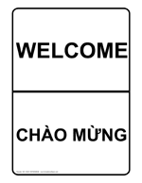

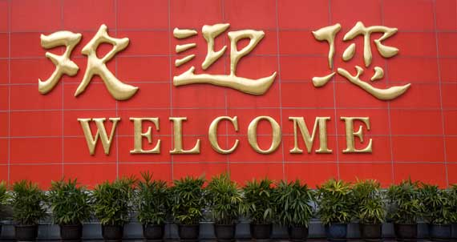

2012 Annual Meeting
November 7, 2012
Dorchester House

Slide 2
Today’s Program
Introduction to BACH
Overview of past year’s work
Elections of Steering Committee
Dinner
“Envisioning a Healthy Boston”

Slide 3
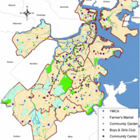
Boston Alliance for Community Health: BACH
Boston’s Community Health Network Area (CHNA)
Founded in 1992
Our Mission: The Boston Alliance for Community Health unites public, private, and non-profit partners in neighborhood-based, data-driven health planning and improvement to influence policymaking, program development, service delivery, and resource allocations that protect, promote, and improve the health and well-being of all Boston residents.

Slide 4
Diverse and growing membership
Elected Steering Committee
Volunteer committees and work groups:
  Health Planning and Improvement
    Data
    Education and Training
    Work Plan
  Community Investment
  Community Engagement and Membership
  Finance
Notes:
Members include neighborhood coalitions
Community health centers
Hospitals
Community Based organizations
Individuals
Our membership has been quite informal but we are moving to a more “official membership.’ The more members we have to powerful our collective voice can be as we advocate for change

Slide 5





Funding this past year came from:
  Boston’s hospitals/Massachusetts Department of Public Health through “Determination of Need” funds
  Boston Public Health Commission “Communities Putting Prevention to Work”
  Harvard School of Public Health (Breathe Free for Kids)
  Dana Farber Cancer Institute (Planet MassCONECT)
  Health Resources in Action (in-kind)

Slide 6
Allston Brighton Health Collaborative
Charlestown Substance Abuse Coalition
The Chinatown Coalition
Codman Square Neighborhood Council
East Boston Collaborative for Families
Franklin Field/Franklin Hill Dorchester Healthy Boston Coalition
Jamaica Plain Tree of Life/Arbol de Vida
Roxbury Community Alliance for Health
South Boston Collaborative Action Network
South End Health Boston
Notes:
Ask people to stand if they are from that neighborhood as you read the list

Slide 7
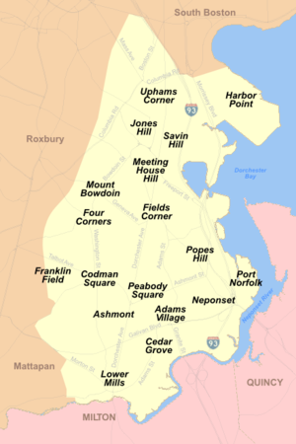
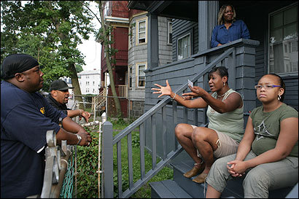
Community Organizing with Health as the Theme:
Engaging with other neighborhoods
North Dorchester (2012-13)
Mattapan (2012-13)
Hyde Park
Roslindale
Mission Hill and Fenway
Notes:
Ask people to stand if they are from that neighborhood as you read the list

Slide 8
Mobilizing for
Action Through
Planning and
Partnership
(MAPP)

Slide 9
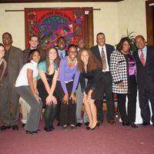
Notes:
One of the reasons we chose this model is that it gives lots of opportunities for residents and others to be engaged in the work and have input into the process.

Slide 10
MAPP Framework
Notes:
Some of you may have seen this before - This is the MAPP framework. It shows the 6-phases of MAPP, which David and Allyson will be explaining in a little bit.
David- describe the hospital requirements for CHA/CHIP/SP and how MAPP fits in – Do I need to do this? Not sure how it fits in here.

Slide 12
Organizing for Success
Rethinking missions
How we do our work
New partnerships – who else needs to be at the table
Engaging Residents
Working while planning:
(some examples)
  Farmer’s Markets
  Smoking Cessation
  Exercise Group
  Substance abuse prevention
  Obesity prevention
  Renewed parks
  Health Equity Training
Notes:
It is not like we have no idea what our communities are dealing with but… taking a step back helps us to se how we can be more effective and how to engage more people in our work.

Slide 13
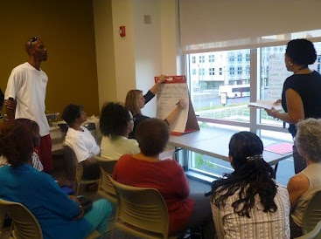
Visioning
On the neighborhood and citywide levels
Creating a vision together that can serve as our “north star” as we plan and implement

Slide 14
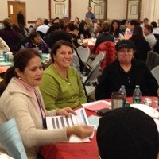
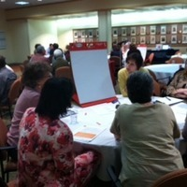
Assessment
We are doing four kinds of assessments:
Community Health Status
  “hard” data, health and other social and economic statistics
2. Community Themes and Strengths
  Neighborhood assets in the physical space
  and social networks
    Mapping
    Focus Groups
    Surveys

Slide 15

Assessment
3. Forces of Change
  What will help us and what will get in the way of creating our vision of a healthy Boston?
4. Local Public Health System Assessment
  How well are all the parts of the system working together to improve public health?

Slide 16
Local Public Health System
Police
Community Centers
Home Health
MCOs
Faith Organizations
Health Department
EMS
Corrections
Hospitals
Parks
Schools
Elected Officials
Doctors
Nursing Homes
Mass Transit
Philanthropist
Environmental Health
Civic Groups
CHCs
Fire
Tribal Health
Economic Development
Laboratories
Drug Treatment
Mental Health
Employers

Slide 17
Collectively, the Four Assessments
Provide insight on the gaps between current circumstances and vision.
Serve as the source of information from which the strategic issues, strategies, and goals are built.
Notes:
Leave 2 minutes for these next 2 slides

Slide 18









Working with Boston’s Hospitals to Assess Community Health
Beth Israel Deaconess
Brigham and Woman’s
Carney
Children’s Hospital Boston
Dana Farber Cancer Institute
Mass General
New England Baptist
St. Elizabeth’s
Tufts Medical Center
Notes:
Hospitals are required by the MA Attorney General and now by the Affordable Care Act to assess the communities they serve. We are working with the hospitals through our coalitions to partner with each other as much as possible. Not all hospitals have the same resources so the collaborations will be different but it is a way for both hpsitals and neighborhoods to use the skills, expereince, and expertise they have to complement each others

Slide 19
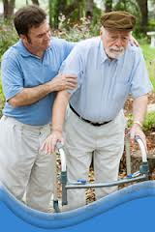
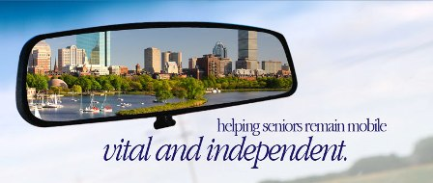
Example of a Strategic Issue, Goal
& Strategy
Strategic Issue:
How can the public health community ensure access to population-based and personal health care services?
Goal:
All persons living in our community will have access to affordable quality health care.
Strategy:
Provide free or reduced cost
transportation services to residents
for whom transportation is a barrier.
Notes:
Mention ITNBoston for seniors

Slide 20




Example of a Strategic Issue, Goal
& Strategy
Strategic Issue:
How can the public health community help increase the number of adolescents who complete high school?
Goal:
All students in Boston public schools will have access to appropriate, high quality health care services in or near a school setting.
Strategy:
Advocate for the establishment of additional school-based health services
Notes:
We know that completing high school and one additional year of education significantly increases the probability of having a healthy adulthood

Slide 21
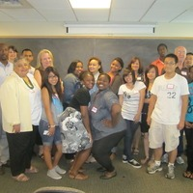
Changing Policy
BACH is committed to increasing prevention resources for prevention and systems change where there can be the greatest impact.
This past year, through funding from BPHC’s Communities Putting Prevention To Work:
  Tobacco Coalitions
  Youth Access and Other Nicotine
  Products Regulation
Notes:
Our focus this past year has been on tobacco related policy. With the active support of our neighborhood coalitions, including petitions with over 400 signatures and numerous people testifying at the Bosotn Board of Health hearings…Bosotn now restricts the sale of any nicotine or tobacco product to people over 18. The “electronic cigarette” had not regulations previously. You did not know how much nicotine there is is in the cartridge or what else was in in it…and a five year old could buy it.
We also had a social media campaign – Face off Against Tobacco – in which hundreds of people had their picture taken in support of raising the price of cigarettes, which is a proven startegy to reduce smoking, particularly among youth who are most sensitive to price

Slide 22
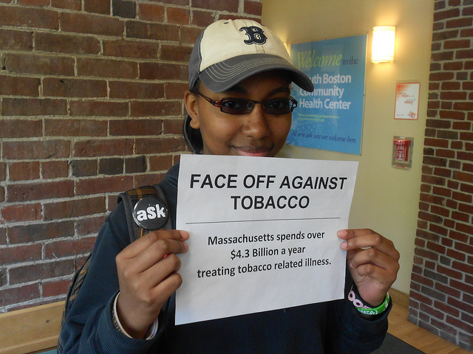
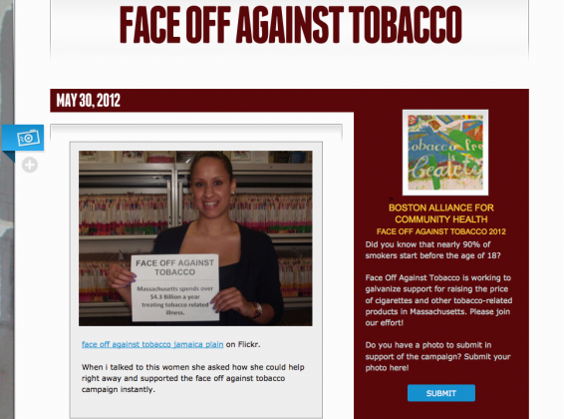
Face off Against Tobacco

Slide 23
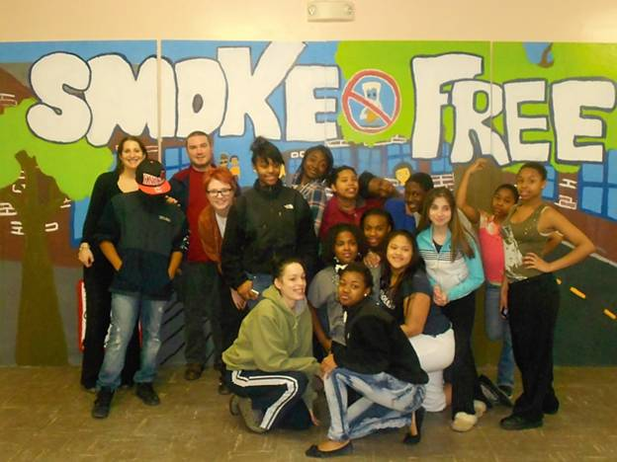
Notes:
Boston Housing Authority smoke free policy
Mural project – South Boston, Codman, Charlestown

Slide 24
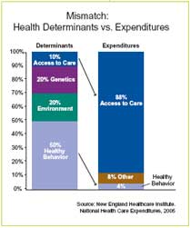

Slide 25
What’s coming next?
Community organizing for health in additional neighborhoods
Assessment activities and goal setting on the neighborhood and citywide levels
New partnerships with other community health and policy initiatives
YOUR involvement in creating a healthier Boston

Slide 26
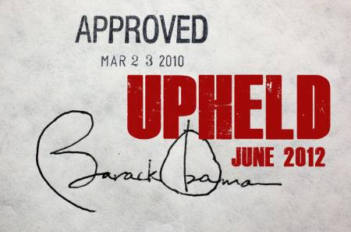



Moving Forward with Optimism
Affordable Care Act implementation
National Prevention Strategy (first ever)
Boston’s REACH Coalition building racial and ethnic approaches to disease prevention
MA Prevention Trust

Slide 27


Moving Forward with Partners
MA Department of Public Health’s Mass in Motion and other initiatives that bring communities together to address
obesity and diabetes
Boston Public Health Commission’s
commitment to reducing health disparities and addressing racism
Notes:
Mass in Motion…in Dorchester
Cracking the Codes – BPHC and BACH supported this film and discussion about racism, health equity, and how to address them

Slide 28
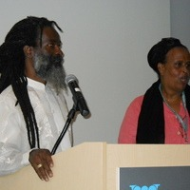
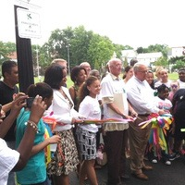
Moving Forward with BACH and YOU
Engaging with
  New neighborhoods
  New organizational partners
  Residents
  Ethnic and racial diversity
Working to create a Boston where everyone from every neighborhood has an equal opportunity to live a
  long
  healthy
  and productive life

Slide 29
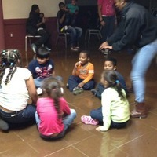


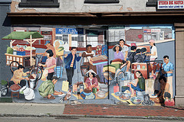
Boston’s teaching hospitals working with neighborhoods to improve communities’ health
Boston’s Community Health Centers supporting neighborhood health initiatives and outreach

Slide 30
Contact us and let’s talk:
www.bostonalliance.org
622 Washington Street, Codman Square,
Dorchester, MA 02124
617-279-2240 extension 509
Beth Rosenshein (Steering Committee)
brosenshein@partners.org
David Aronstein(general questions)
daronstein@hria.org
Jamiah Tappin(community organizing)
jtappin@hria.org
Allyson Scherb(MAPP and health planning)
ascherb@hria.org
Sharon Odametey (BreatheFree for Kids)
sodametey@hria.org

