Slide 1
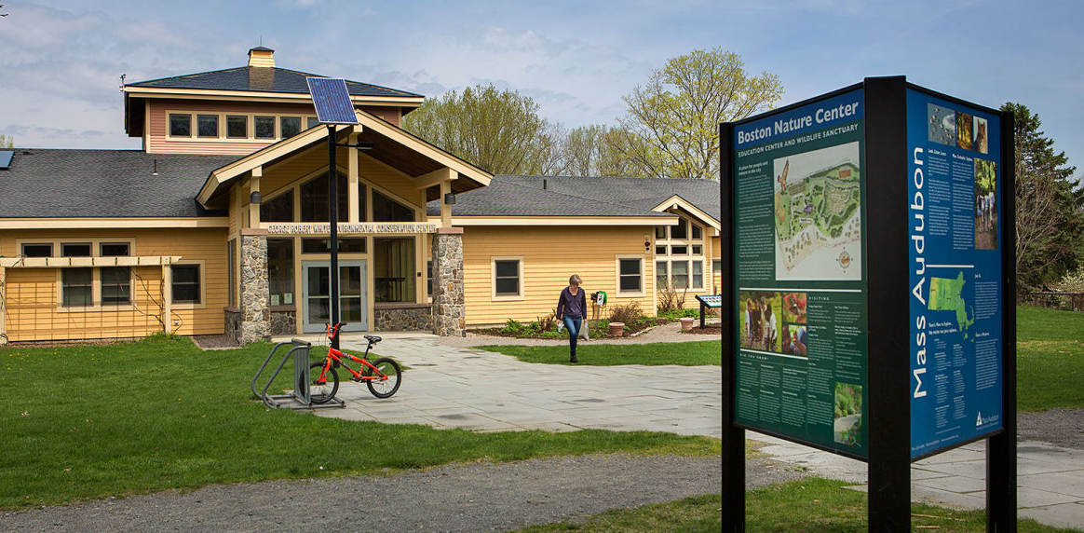
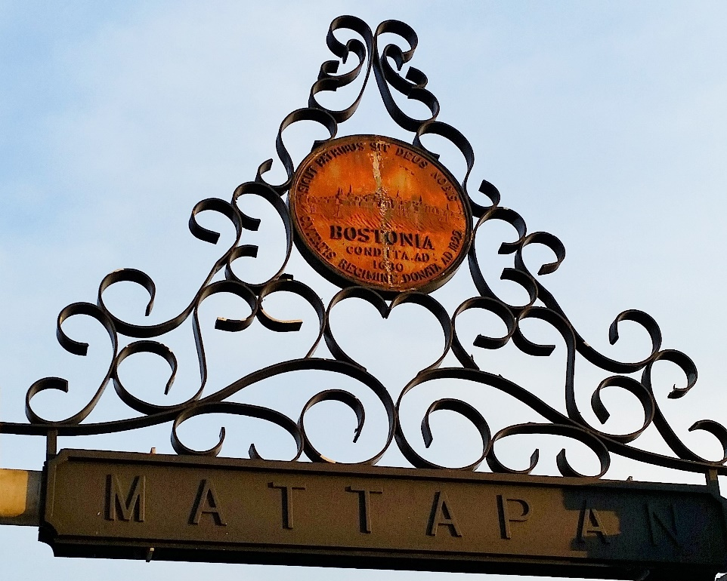
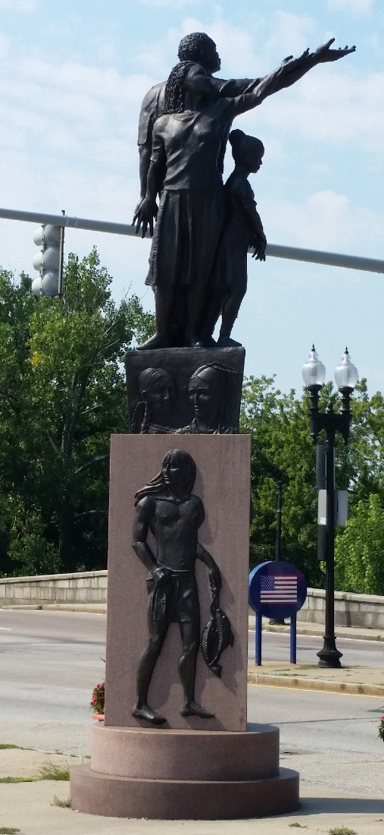
Let’s Get Healthy, Boston! Initiative
Mattapan Food and Fitness Coalition’s
Healthy Community Champions
BACH Steering Committee Meeting March 28, 2016

Slide 2
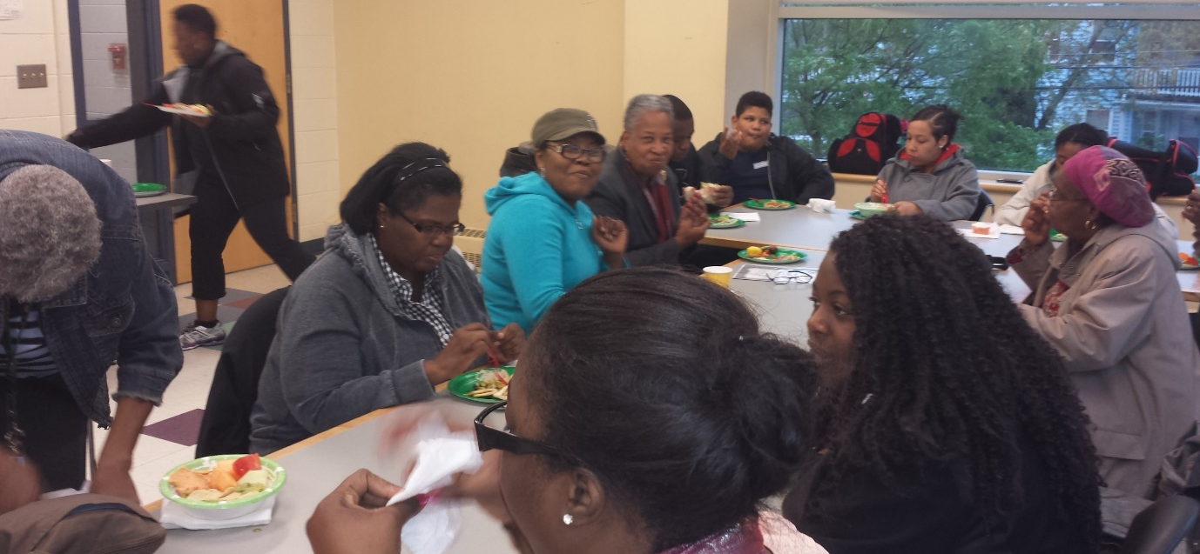
Mattapan FOOD AND FITNESS COALITION
Mattapan Food and Fitness Coalition was founded to address the high rates of obesity, diabetes, hypertension, and heart disease.
Because of these health disparities, Mattapan has been identified as one of two priority neighborhoods under the Partnership to Improve Community Health grant..
Fifteen residents work an average of five hours as Healthy Community Champions (HCCs)
The HCCs are tasked with encouraging their neighbors to make voluntary policy, system, and environmental (PSE) changes in the three areas:
Active Transit
Healthy Food and Beverages
Smoke-Free Housing

Slide 3
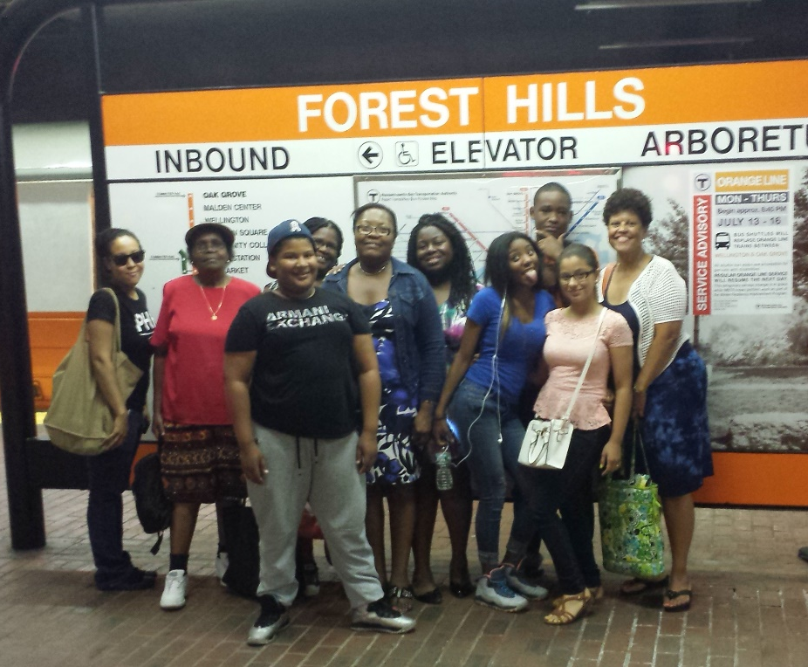
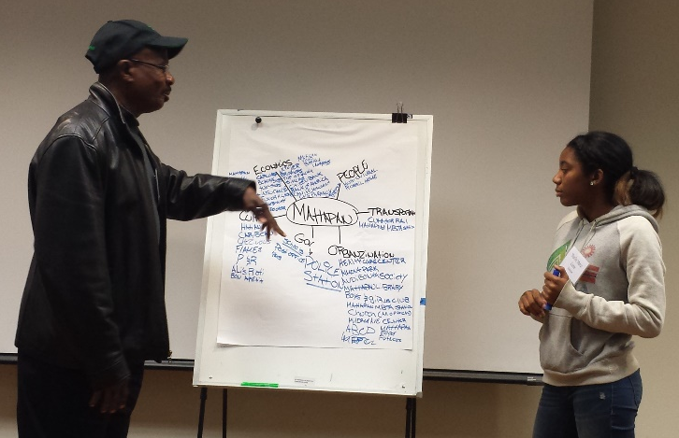
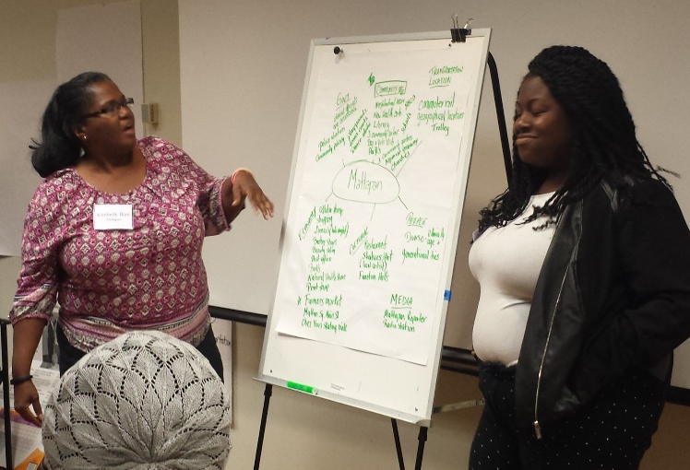
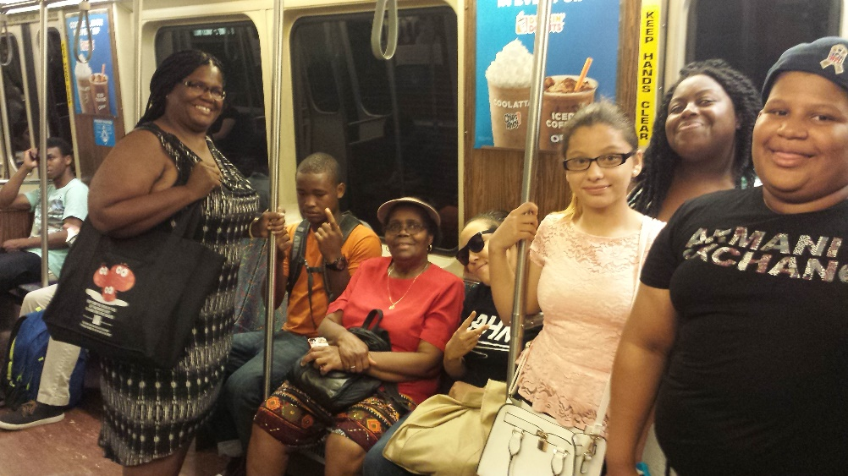
eight weeks of training and team building
JUNE-JULY 2015

Slide 4
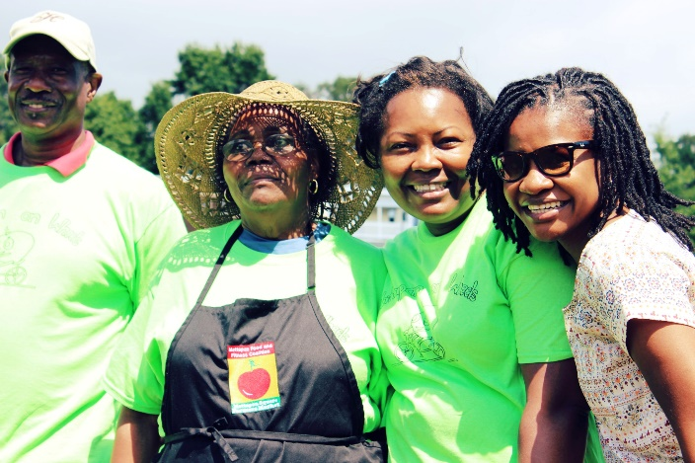
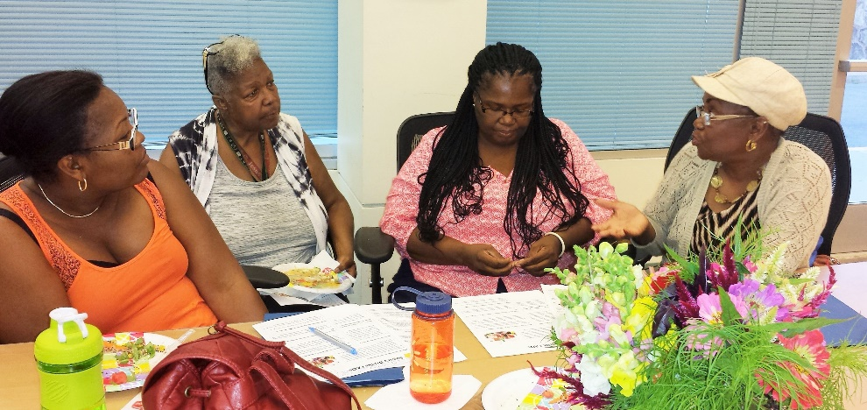
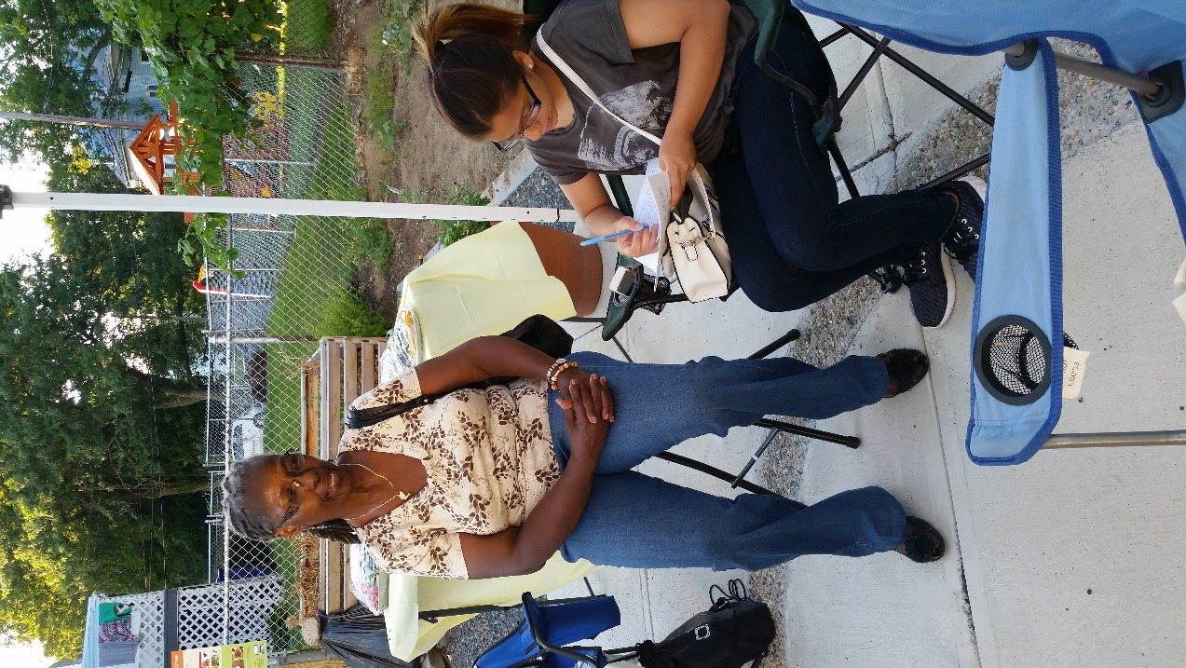
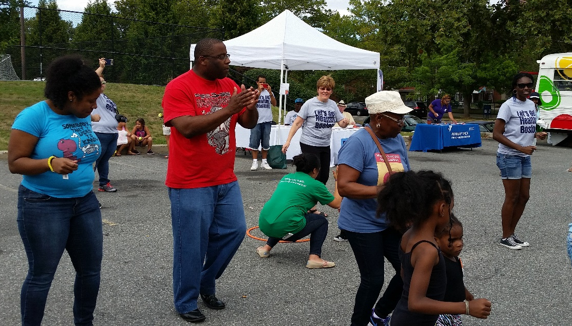
AUGUST – SEPTEMBER 2015
Surveyed residents at Mattapan Food and Fitness Coalition Events
Mattapan Moving for Life
Weekly Farmers’ Market
Mattapan on Wheels
Playway
Community Events
Mattapan Community Health Center’s Health Care Revival
Gallivan Housing Development’s Unity Day
First Day of School and Open House visits to Mattahunt Elementary School
Rockin’ with the Raptors at the Boston Nature Center
Weekly Check-Ins

Slide 5
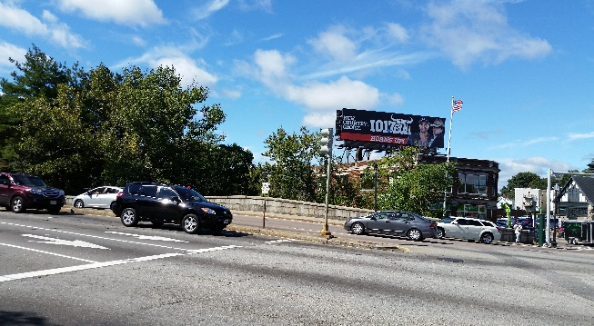
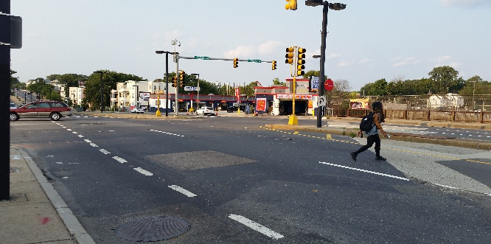
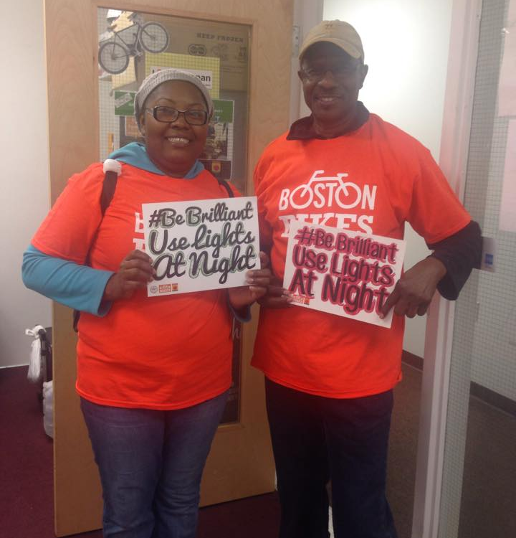
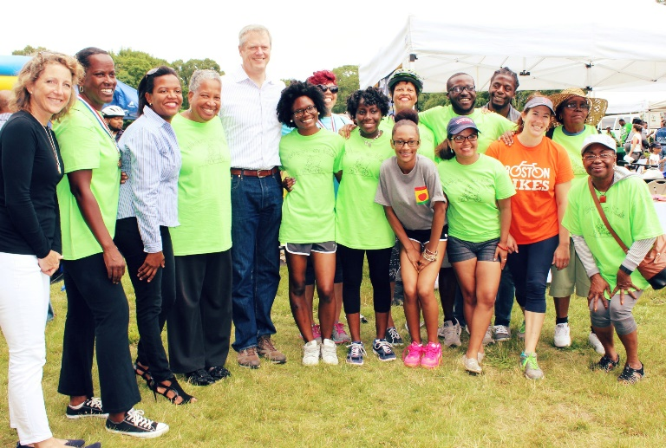
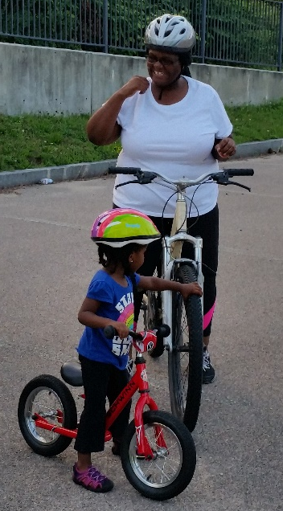
Dezi, Hugh, JoyAnn, Mireille & Raúl
ACTIVE TRANSIT
The HCCs are actively working to increase opportunities for access to safe walking and biking opportunities for residents in Mattapan. The PSE changes will be achieved by continuing our work with:
Conducting neighborhood walks, supporting community bike rides and Mattapan on Wheels
Fairmount Greenway Task Force & Neponset River Greenway Council
Hike4Life & Door to the Outdoors
City and State Agencies & Elected Officials about transit equity issues
Boston Bikes for the Women’s Learn-to-Ride Clinic, Roll It Forward
program and continued advocacy for Hubway in Mattapan
Vision Zero to collect transportation safety concerns from neighbors
Mattahunt and Charles H. Taylor Elementary Schools for the Safe Routes to Schools biking/walking program
walkBoston to conduct walk audits and assessments

Slide 6
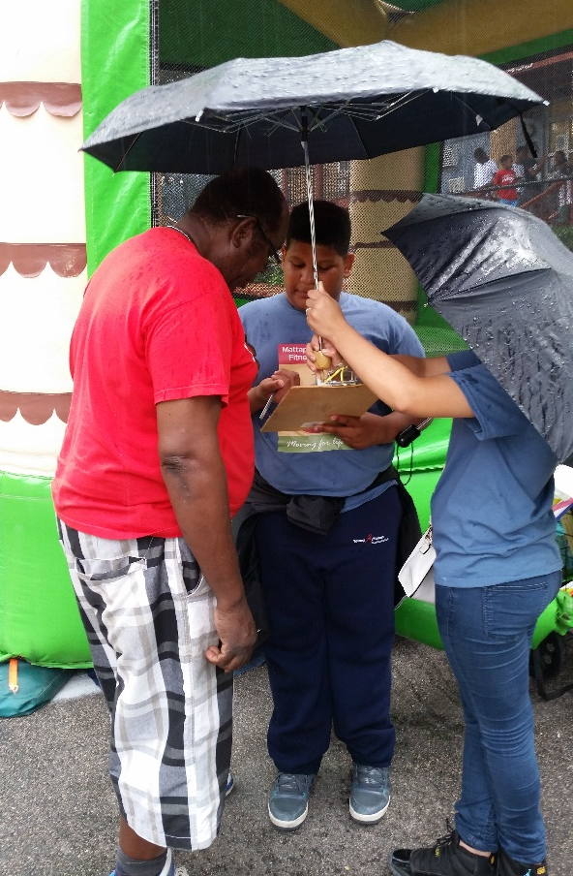
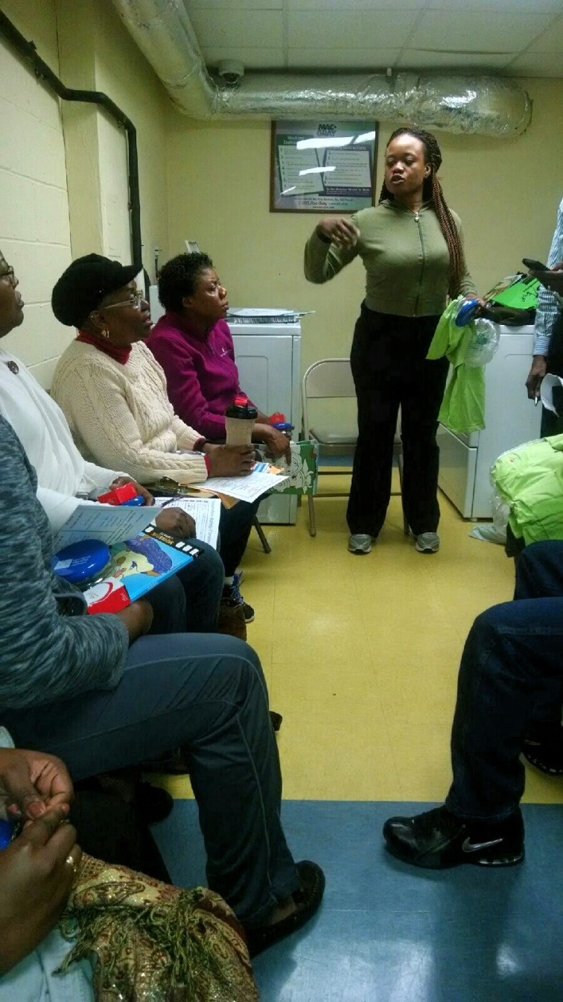
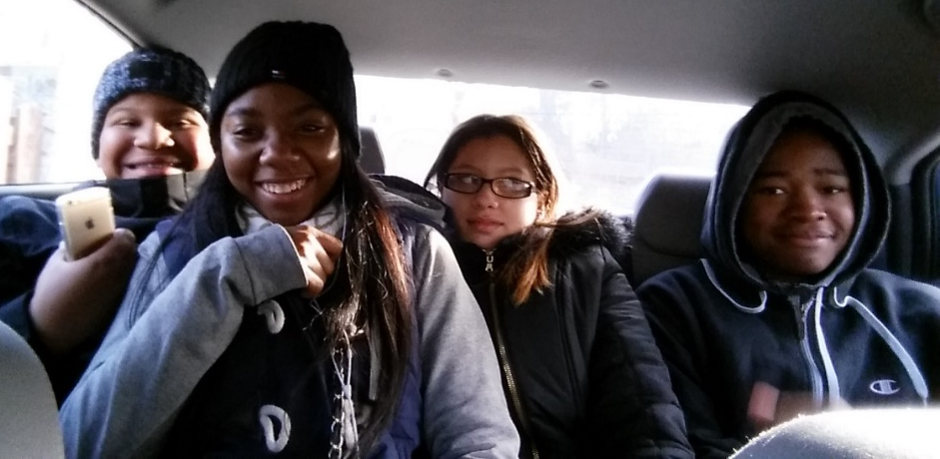
SMOKE-FREE housing
The HCCs are working to decrease the number of smoke-free housing units in Mattapan. Efforts to achieve PSE changes include:
Partnering with the management of Nuestra Comunidad Development Corporation to transition the Adams Court housing development on River Street to smoke-free.
Providing a resident survey in English and Spanish to Nuestra Comunidad’s resident manager.
Conducting an inventory of the larger multi-unit residential complexes in Mattapan.
Identifying other strategies (related to HFB or AT) to engage in conversation with these neighbors.
Barbara, Heracles, Kim, Robyn, and SharDre

Slide 7
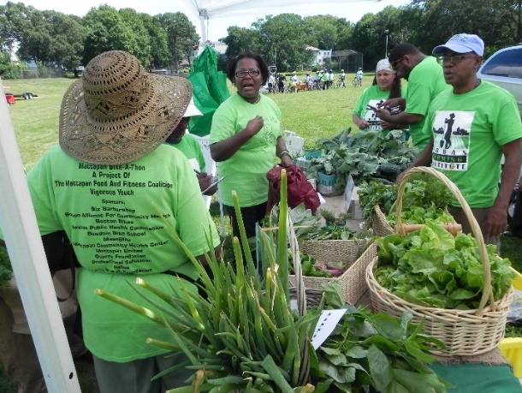
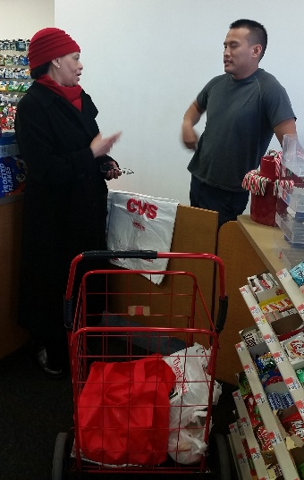
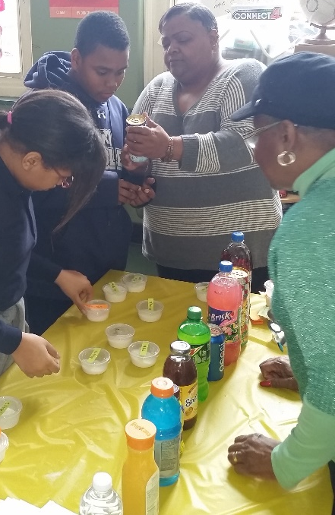
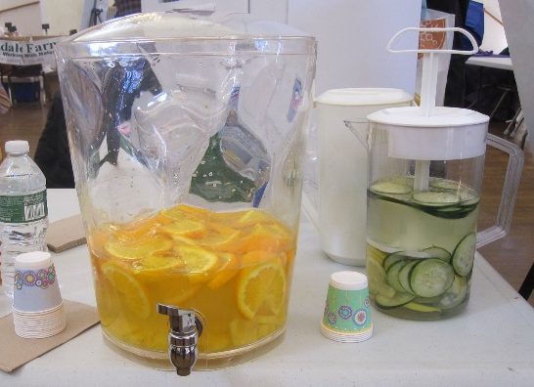
Healthy FOod & Beverages
The HCCs are working to increase access to fresh and affordable healthy foods and beverages.
Year One Activities
Spent almost every Saturday at the Mattapan Farmers’ Market surveying customers. Found that many residents were not aware of the weekly market.
Approached the management at the national pharmacies in Mattapan to promote non-sugary beverages.
Year Two Activities - Priority Project: Sharing the benefits of buying fresh produce at the Mattapan Farmers’ Market
Conducted a food source inventory in Mattapan
29 restaurants serving mostly fast food; 15 on Blue Hill Ave
5 liquor stores
1 grocery store
Working with the market manager to design a strategic plan to promote the market.
Location change
Increasing number of farmers and non-food vendors
Extending the non-sugary beverage campaign to
local pharmacies, corner stores and bodegas.
HCCs will be better informed to direct neighbors to food assistance programs.
Share a sugary beverage display at schools,
youth groups and community organizations.
Betty, Gillian,
Leonide, Luz
& Norma

Slide 8
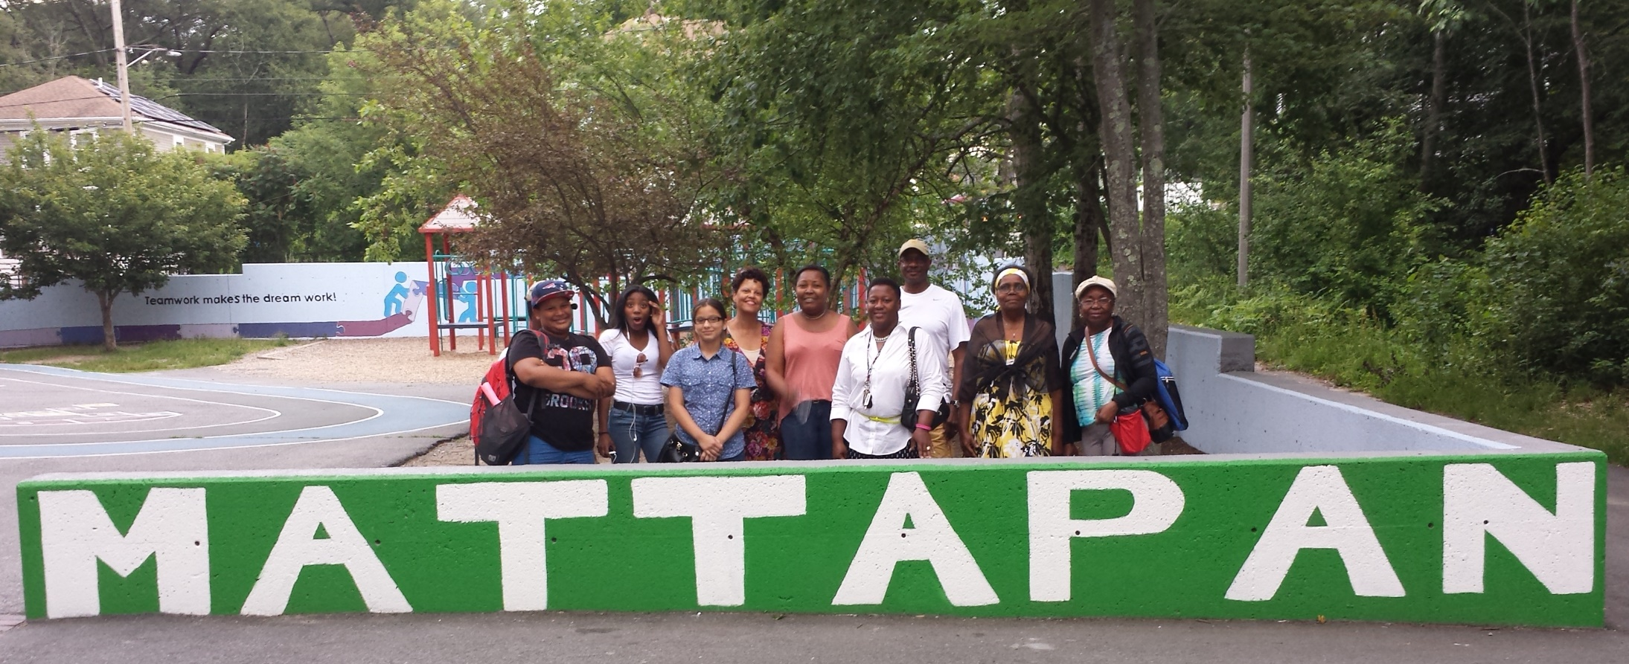
#MattapanMatters
#LetsGetHealthyBOS
Facebook: Mattapan Food and Fitness Coalition
Twitter: MattapanFoodFit

