Slide 1
Boston: A City for Immigrants
Carol Q. León
Outreach and Engagement Coordinator

Slide 2
MOIA Background
The Mayor’s Office for Immigrant Advancement was created in 1998 as the Mayor’s Office of New Bostonians. Our goal is to involve immigrants in Boston’s civic, social, and cultural life.
We make sure that immigrants have the same access to services that all residents enjoy and we work hard to highlight the role immigrants play in Boston’s growth.

Slide 3
“Generations of immigrants from every corner of the world, including my own parents, have made Boston their home. And it is this diversity that make us a unique city…We are a welcoming city, and I want all our immigrants to know that they don’t have to leave their cultures behind to become American in Boston.”
- Mayor Marty Walsh

Slide 4
Demographics

Slide 5
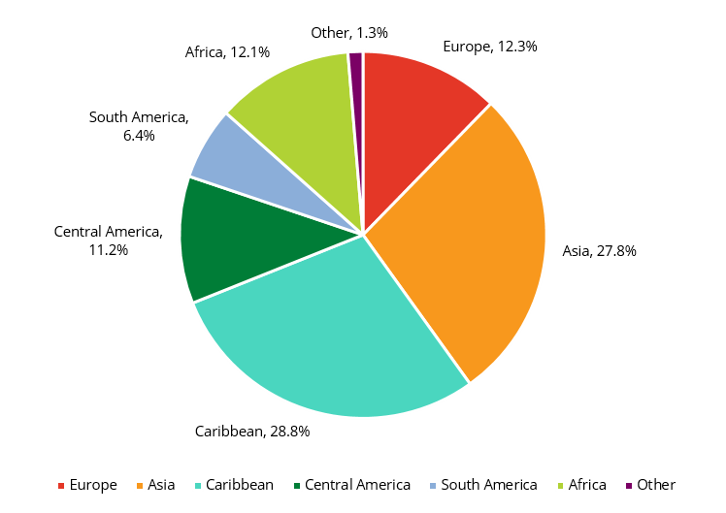
1 in 4 Bostonians is an Immigrant
Boston is home to approximately 177,461 foreign-born people. At 27.1% of Boston’s population, this is higher than the percentages of both MA and the U.S.
Boston’s foreign population increased 19.2% from 2000 to today.
Boston’s foreign-born population hails from more than 150 countries.
51.1% of Boston’s children age 0 to 17 live with at least one foreign-born parent.
Caribbean: 28.8%
Asia: 27.8%
Europe: 12.3%
Africa: 12.1%
Central America: 11.2%
South America: 6.4%
Other: 1.3%
Notes:
2014 ACS

Slide 6
More About Immigrants in Boston
Naturalized citizens made up 49% of Boston’s foreign-born population.
51.1% of Boston’s children age 0 to 17 lived with at least one foreign-born parent in 2014.
In 2013, almost 36% of Boston’s residents spoke a language other than English at home – up from only 13% in 1980.
Linguistically isolated households – households where no one 14 or older spoke English at least very well – increased to 12% in 2010, up from 8% of households in 1990.
Source: Boston By the Numbers 2015 & Boston’s Shifting Demographics
Boston Redevelopment Authority, Research Division
http://www.bostonredevelopmentauthority.org/research-maps
Notes:
2014 ACS

Slide 7
Top 10 Countries of Origin Among New Bostonians
Source: U.S. Census Bureau, 2014 American Community Survey, Public Use Microdata Sample,
BRA Research Division Analysis
Notes:
Carol – can you make this graph bigger?

Slide 8
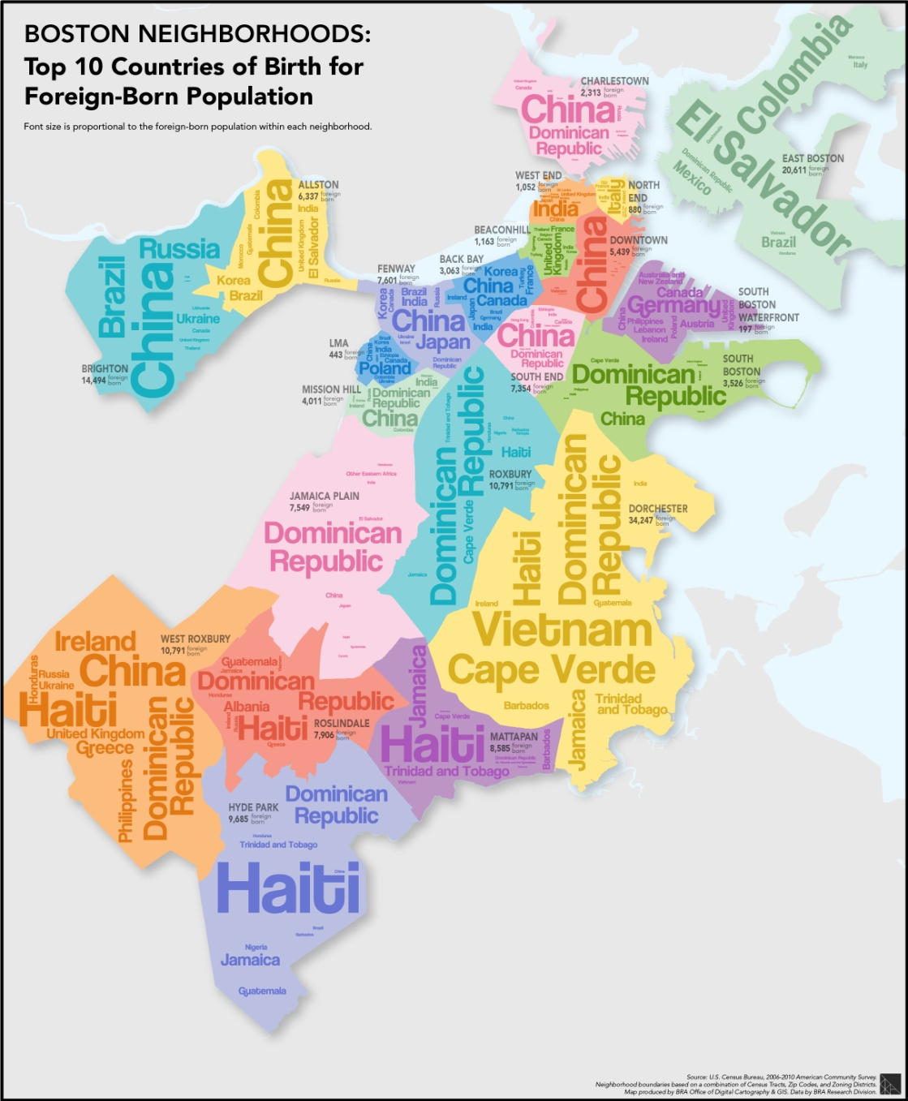
Font size is proportional
to the
foreign-born population within each neighborhood
Source: 2006-2010 American Community Survey

Slide 9
Number of Neighborhoods in Boston
22

Slide 10
A Multilingual City
Boston’s neighborhoods with the highest share of residents speaking a language other than English at home are:
East Boston (68.5%)
Dorchester (58.4%)
Roslindale (40.6%)
Roxbury (40.5%)
Hyde Park (37.9%)
Allston (37.8%)
East Boston has the highest share of residents who speak Spanish at home (52.3%), followed by Roxbury (25.2%) and Jamaica Plain (21.9%).
19.6% of Downtown residents speak Chinese.
18.4% of Mattapan residents speak French or French Creole.
Source: U.S. Census Bureau, 2007-2011 American Community Survey, BRA Research Division Analysis
10

Slide 11
Most Common Non-English Languages Spoken at Home

Slide 12
Programs and Initiatives

Slide 13
Community Education and Engagement
MOIA routinely holds events, clinics and information sessions in the community to inform residents about policies and programs that could impact them.
Clinics include Citizenship, DACA/DAPA, immigration screening
In July 2016, more than 100 individuals attended a screening clinic to learn if they qualify for some form of immigration relief.

Slide 14
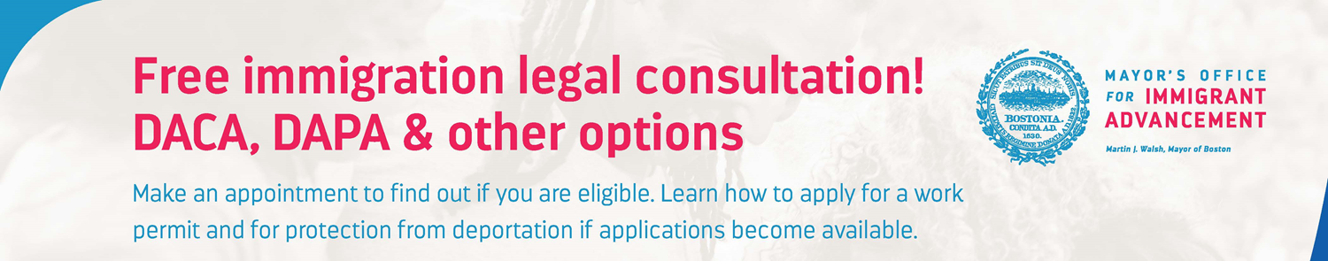
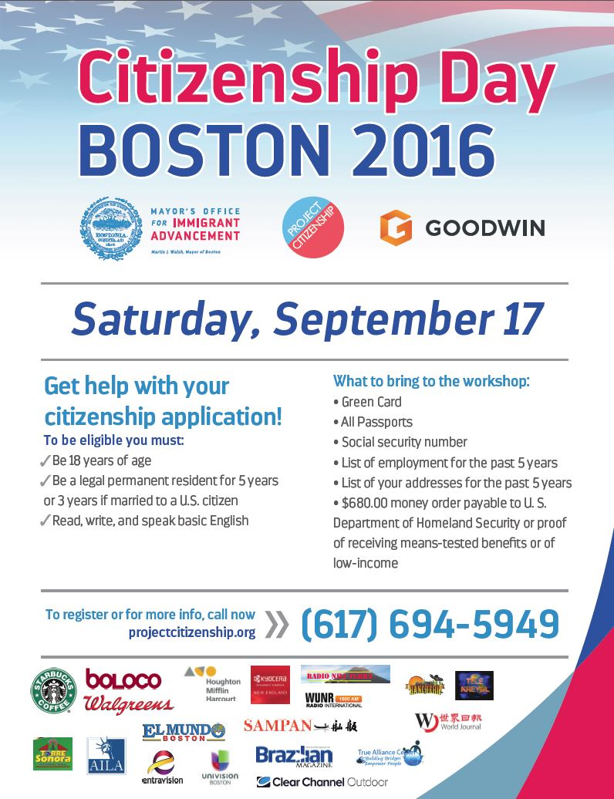
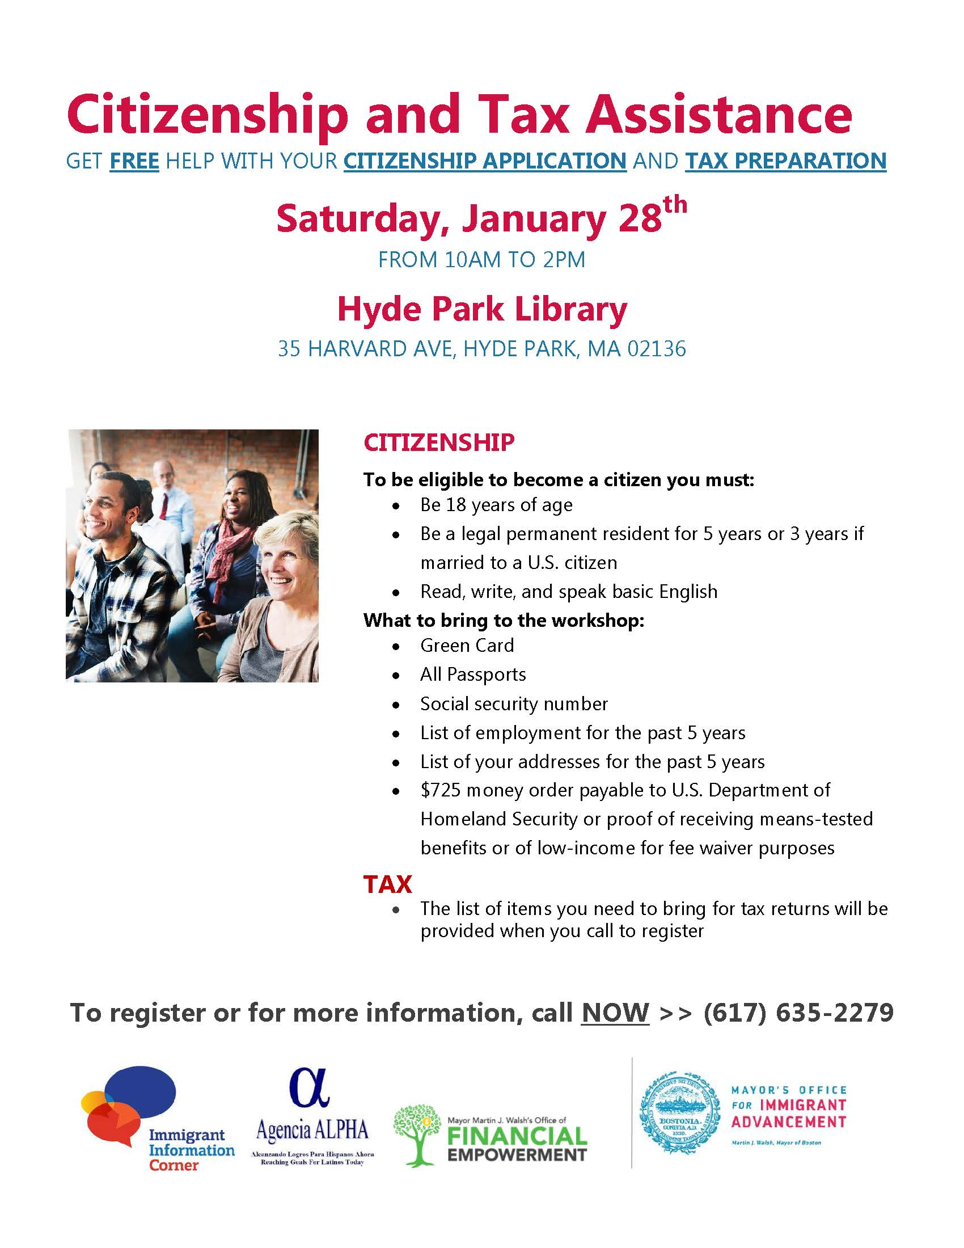
MOIA Services

Slide 15
Immigrant Information Corners
The Immigrant Information Corners (IIC) are meant to serve as information stations for Boston’s immigrants and refugees.
These corners are currently set-up in all 24 branches of the Boston Public Library and will be set up 3 Boston Centers for Youth and Family.
They offer access to citizenship information, financial empowerment information, and public and community resources in multiple languages.

Slide 16
USCIS Programs

Slide 17
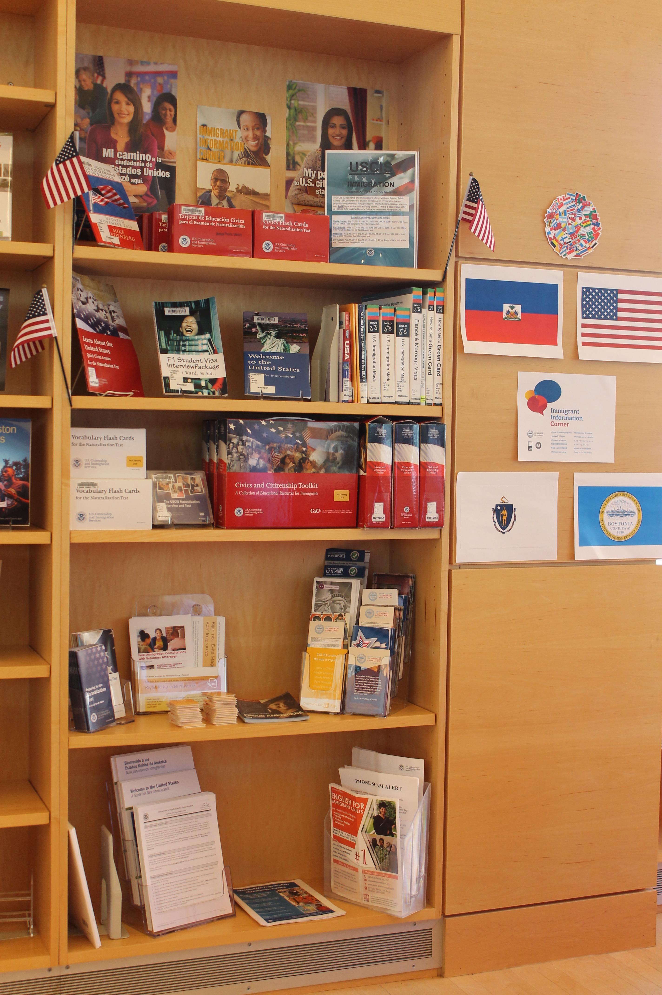
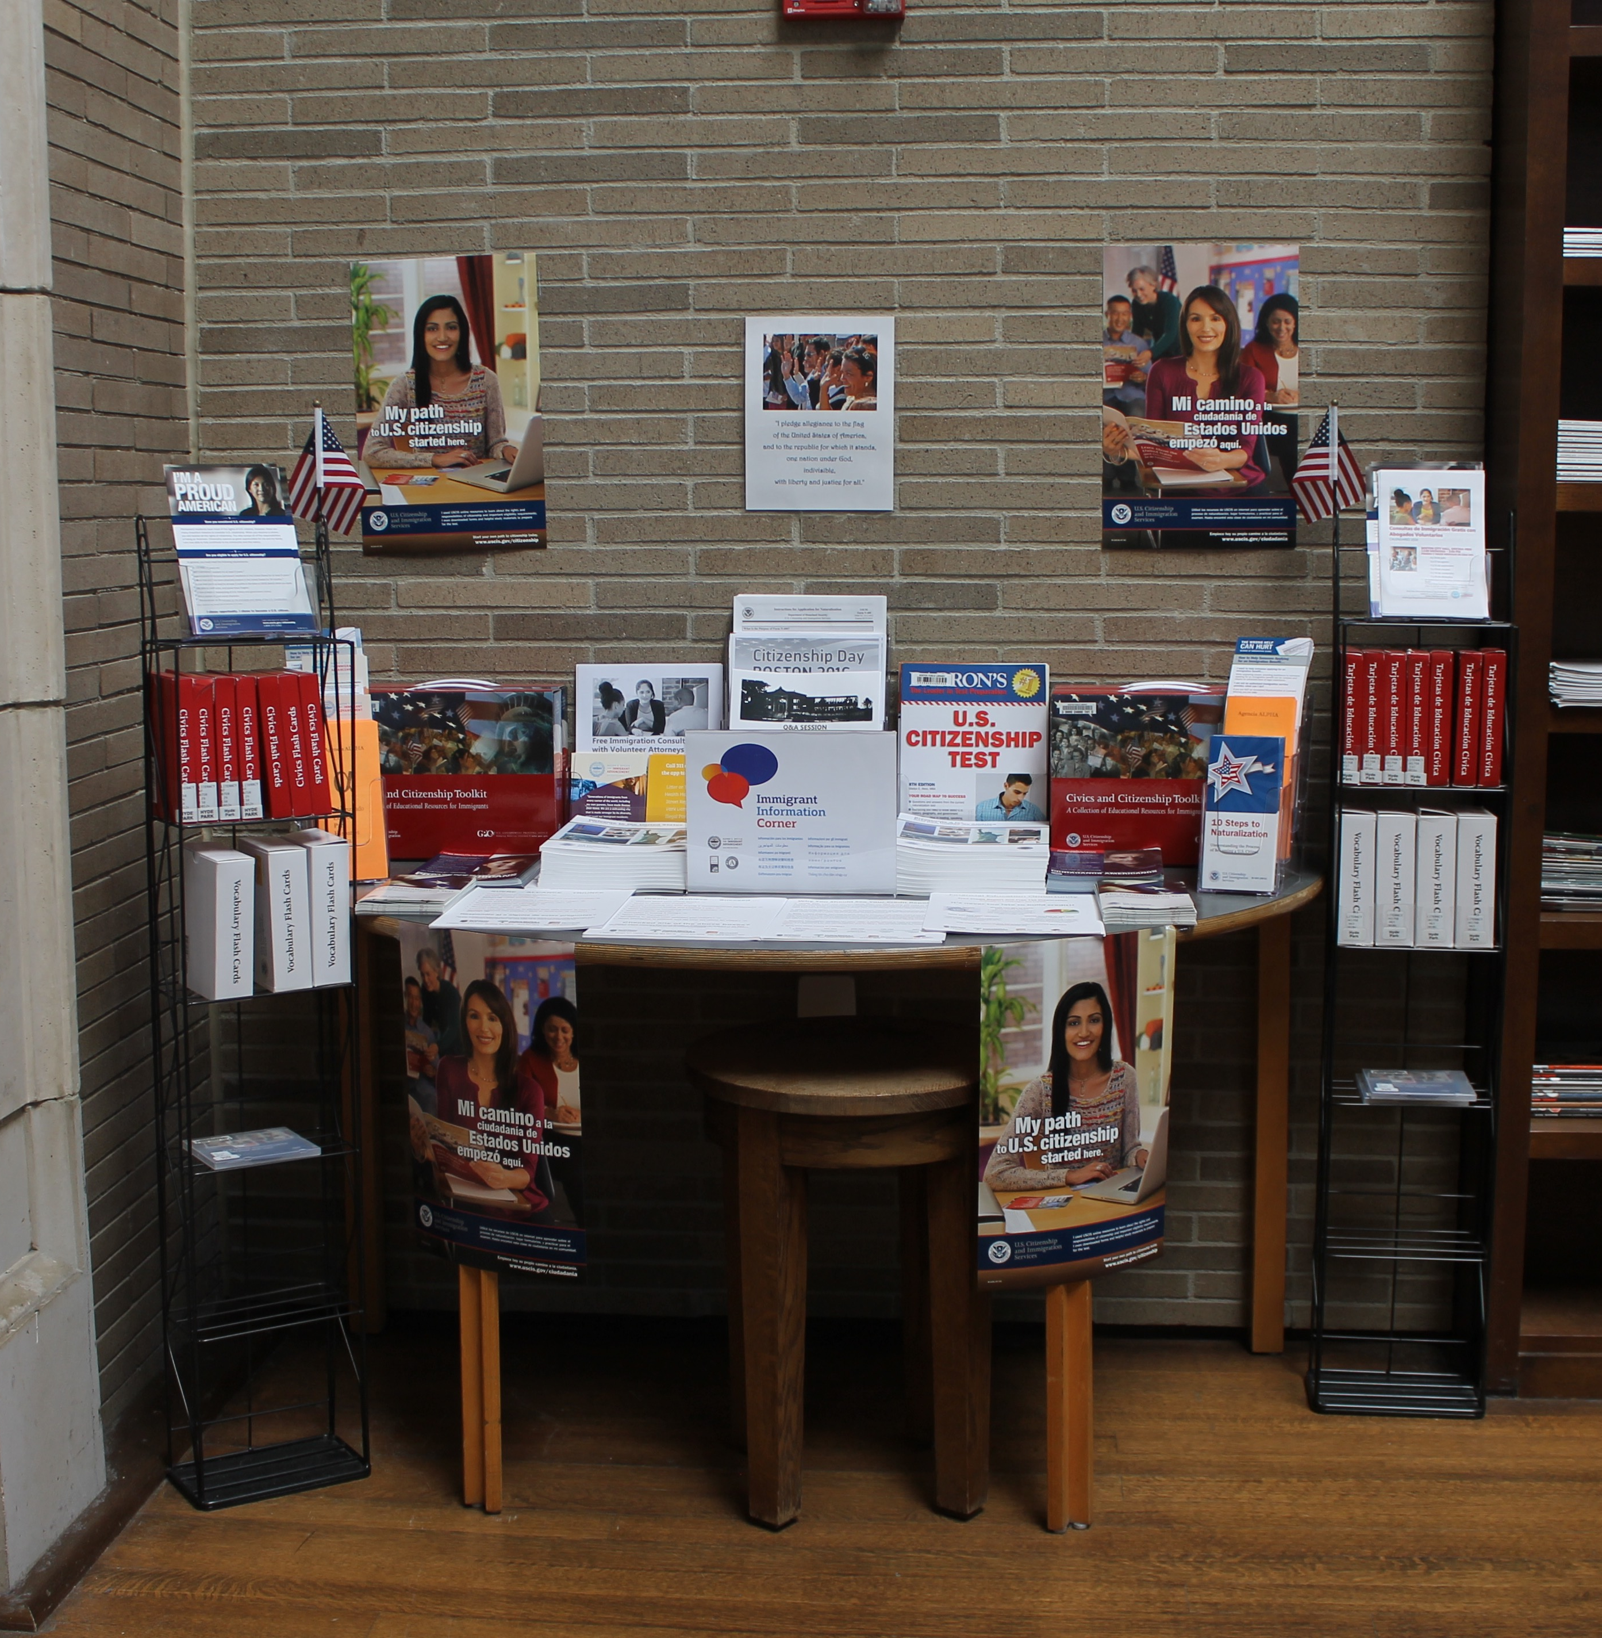
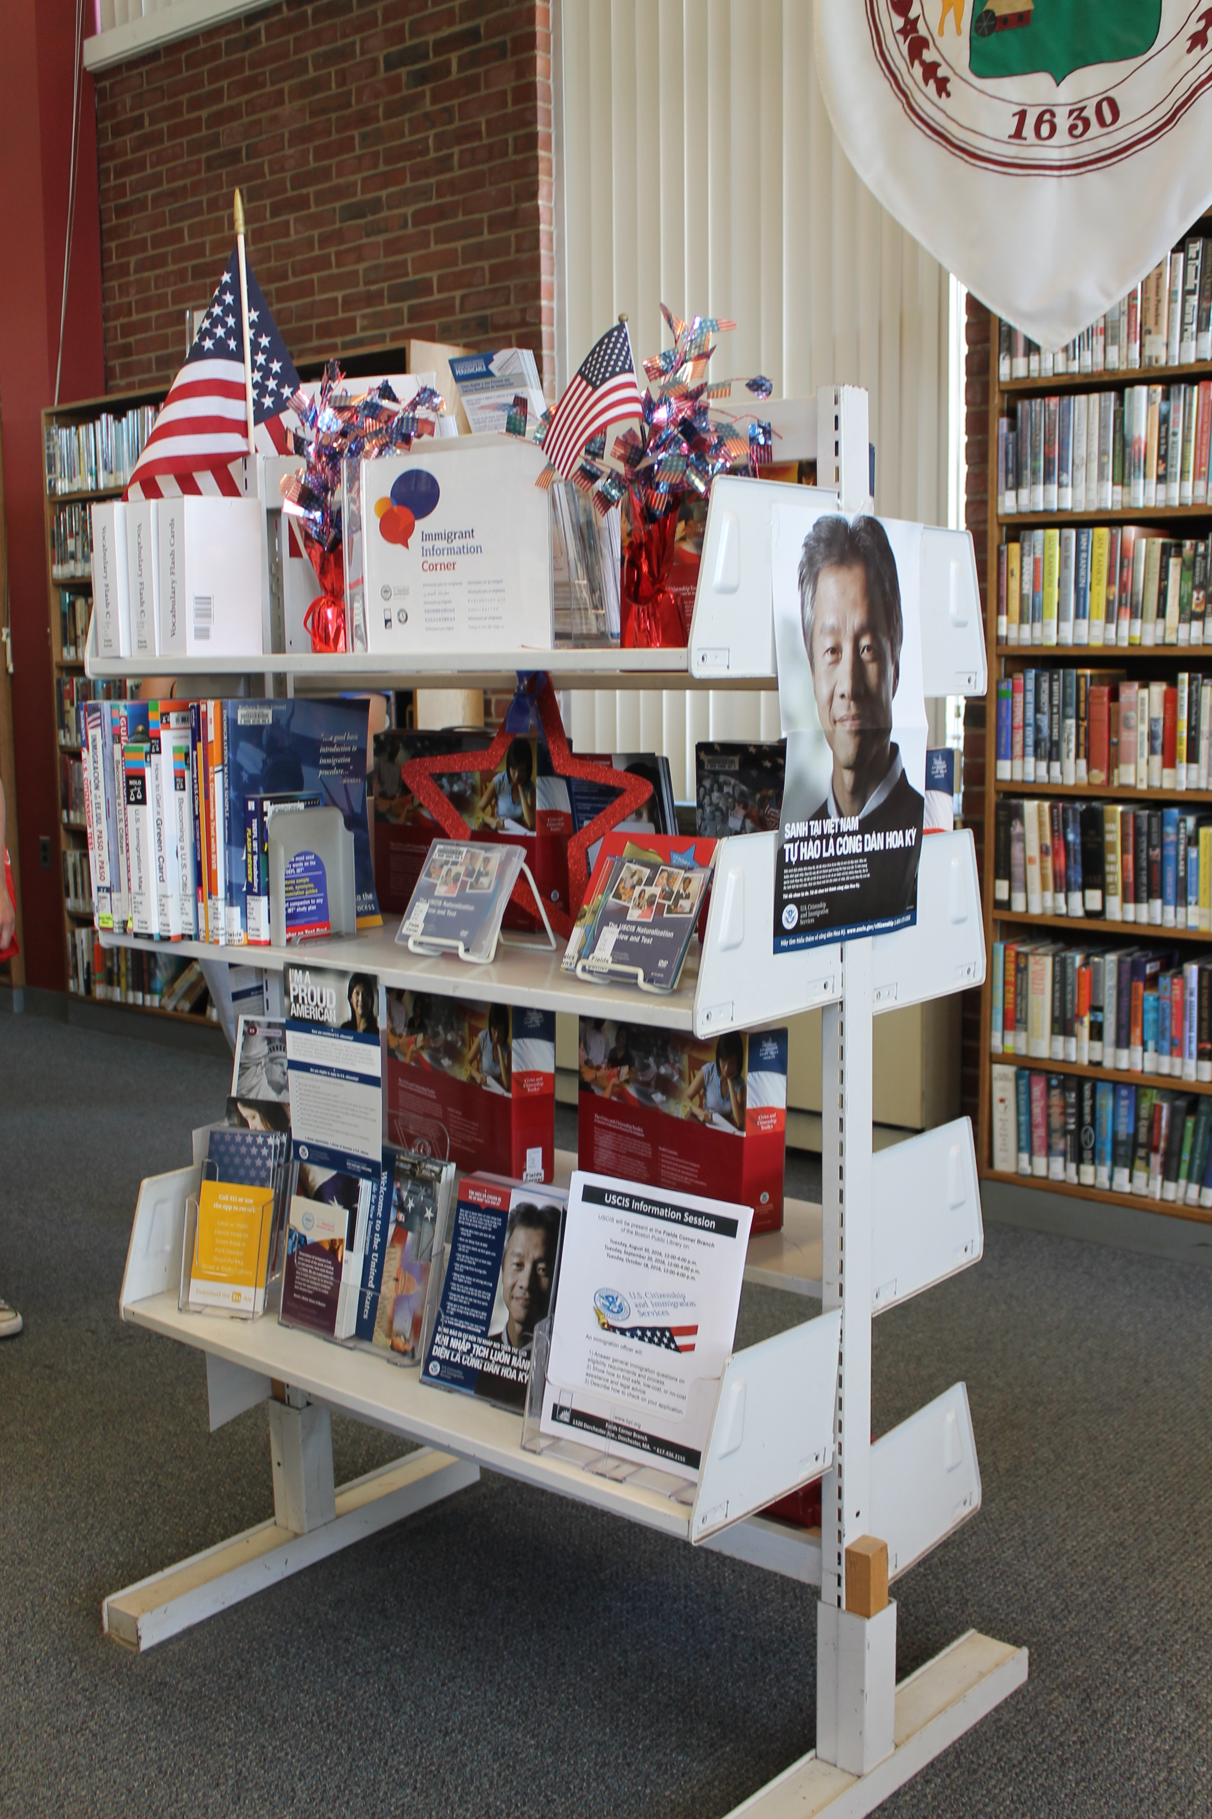
Immigrant Information Corners
Mattapan Library
Hyde Park Library
Fields Corner

Slide 18
Know Your Rights Presentations
Collaboration with PAIR Project, an organization that provides free legal services to asylum-seekers and promotes immigrants rights.
Goals of the presentation:
Understanding your rights when encountered by immigration officers.
Understanding your current immigration status.
Understanding rights in immigration court.
Understanding where to go for help.

Slide 19
Immigrant and Refugee Community Forum

Slide 20
City of Boston Resources

Slide 21
City Services Available to Immigrants Regardless of their Status
Community & After School Programs
BCYF, Department of Youth Engagement and Employment, BPL
Domestic Violence, Child Abuse, Elder Abuse
SafeLink
Elder Services
Elderly Commission
Education
BPS Welcome Centers, Support for ELL Students, Scholarships
Food Assistance
FoodSource Hotline, SNAP*, WIC*
Healthcare
Mayor’s Health Line
Homelessness
Emergency Shelter Commission (Individuals), Massachusetts Executive Office of Housing and Development (Families)
Housing
Boston Housing Authority, Inspectional Services, Office of Fair Housing and Equity, Department of Neighborhood Development

Slide 22
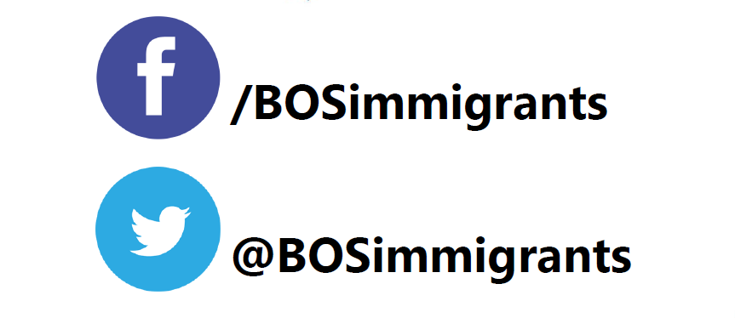
Contact MOIA
Boston City Hall
1 City Hall Sq. Office 806
Boston, MA 02201
Phone Number: 617-635-2980
Website: boston.gov/immigrants
Email: carol.leon@boston.gov
Follow us on Twitter and Facebook!

Slide 23
THANK YOU!

