Slide 1
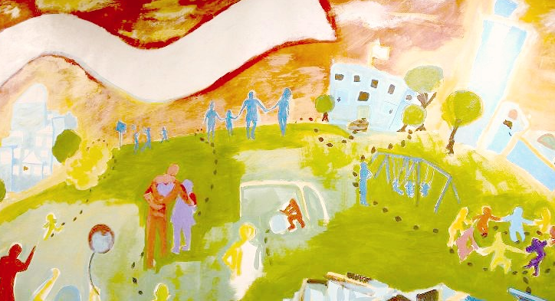
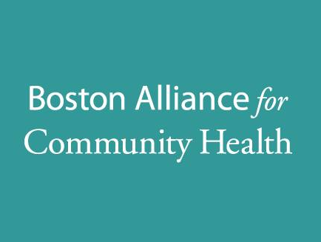
IMPROVING HEALTH
THROUGH COMMUNITY PARTNERSHIPS
NEIGHBORHOOD PLANNING AND
COLLECTIVE ACTION
2015 ANNUAL MEETING:
Building Healthy & Resilient Communities
Notes:
DAVID A. Welcome the Boston Alliance for Community Health’s 2015 Annual Meeting. My name is David Aronstein, and I have had the privilege of being BACH’s Director for the past 5 years. We are excited to be here in Roxbury at the Bruce Bolling Building as it reflects some of the positive developments in Boston’s neighborhoods and honors a leader, Bruce Bolling, Boston’s first African-American President of City Council

Slide 2
BACH
COMMITTEE UPDATES & GRANTEE HIGHLIGHTS
BACH INITIATIVES: AHEAD & LET’S GET HEALTHY, BOSTON!
HEALTHY COMMUNITY LEADERSHIP
AWARDS
KEY NOTE:
DR. ATIYA MARTIN
Q&A
STEERING COMMITTEE ELECTIONS
Notes:
DAVID. Our program this evening will highlight some of the issues BACH’s members throughout Boston’s neighborhoods have been addressing as well as some of their accomplishments over the past year. We will honor five community members who have demonstrated their leadership in improving the health of Boston’s residents. We will hear from Boston’s first Chief Resilience Officer, Atyia Martin about her goals and the importance of social resilience and we will elect the 2016 members of the BACH Steering Committee. All of these activities are a fitting tribute to Councillor Bolling whose life’s work reflected increased opportunity, resilience, and quality of life for Boston’s communities of color and its most vulnerable residents.
We want to start our program by showing you a 7 minute video that the Community Engagement and Membership Committee made, produced by BACH’s Manager of Organizing and Communications, Jamiah Tappin. We want to start with this because it is a really clear explanation of some often complex concepts such as social determinants of health and health equity that lie at the core of the work BACH’s members work on every day. The second reason we wanted to show this to you is that we are very proud of it and want to encourage you to use it in your own work. It can be seen on the Bostonalliance channel of You Tube.

Slide 3
Making the Connections Video: https://www.youtube.com/watch?v=lWgcN2DPOzM

Slide 4
STEERING
COMMITTEE
COMMUNITY COALITIONS
Arnesse Brown
South End Healthy Boston Coalition
Sara Coughlin
Charlestown Substance Abuse Coalition
Juan-Carlos Ferrufino
East Boston Collaborative for Families
Valerie Frias, Chair
Allston Brighton Health Collaborative
Daryl Goldstone
Codman Square Neighborhood Council
Chien-Chi Huang
Healthy Chinatown Alliance
Cynthia Lewis
Mattapan United
Jamiese Martin
Franklin Field/Franklin Hill Dorchester Healthy Boston Coalition
John Riordan
Jamaica Plain Tree of Life/Arbol de Vida
Kay Walsh
South Boston CAN
HOSPITALS &
HEALTH CENTERS
Magnolia Contreras
Dana Farber Cancer Institute
Denise de las Nueces
Boston Health Care for the Homeless
John Erwin, Treasurer
Conference of Boston Teaching Hospitals
Ryan Ribeiro
Harbor Health Services
COMMUNITY-BASED ORGANIZATIONS
Philip Gonzalez
Community Catalyst
Lilly Marcelin
Resilient Sisterhood Project David Price
Nuestra Comunidad Development Corporation
Charlotte Spinkston, Clerk
Urban Pride
CITY & STATE HEALTH DEPARTMENTS
Damon Chaplin
MA Department of Public Health
Vivien Morris
Boston Public Health Commission
Notes:
DAVID Now it is my pleasure to introduce the Chair of the BACH Steering Committee, Val Frias who is Associate Director of the Allston Brighton Community Development Corporation and Co-Chair of the Allston Brighton Health Collaborative, one of the 10 neighborhood coalitions affiliated with BACH.
VAL FRIAS The BACH Steering Committee guides our work and is responsible for tracking how we are doing in meeting our goals. The members represent neighborhood coalitions, community health centers, hospitals, community-based organizations, the Boston Public Health Commission and the Massachusetts Department of Public Health. We will be having our election for Steering Committee towards the end of this meeting tonight but I want to acknowledge and thank this past year’s members: Please hold your applause until I have read all the names!
Arnesse Brown South End Healthy Boston Coalition
Magnolia Contreras Dana Farber Cancer Institute
Sara Coughlin Charlestown Substance Abuse Coalition
Denise de las Nueces Boston Health Care for the Homeless
John Erwin Conference of Boston Teaching Hospitals
Juan Carlos Ferrufino East Boston Collaborative for Families
Val Frias, Allston Brighton Health Collaborative
Daryl Golstone Codman Square Neighborhood Council
Phillip Gonzalez Community Catalyst
Chien-Chi Huang Healthy Chinatown Alliance and Asian Women for Health
Vivien Morris Boston Public Health Commission
Cynthia Lewis Mattapan United
Lilly Marcelin Resilient Sisterhood Project
Jamiese Martin Franklin Field/Franklin Hill Dorchester Healthy Boston Coalition
David Price, Nuestra Comunidad Development Corporation
Ryan Ribeiro Harbor Health Services, Inc.
John Riordan Jamaica Plain Tree of Life/Arbol de Vida Coalition
Charlotte “Dee” Spinkston (Clerk) Urban PRIDE
Kay Walsh South Boston Collaborative Action Network
I would also like to thank our current funders which include:
Boston Public Health Commission
Beth Israel Deaconess Medical Center
Boston Medical Center
Brigham and Women’s Hospital and Brigham and Women’s at Faulkner Hospital
Steward HealthCare – St. Elizabeth’s Hospital and Carney Hospital
Public Health Institute
And a special thanks to our fiscal sponsor Health Resources in Action where we make our home and who helps us stay on track financially and always looks for ways to connect BACH and its members to innovative public health initiatives.

Slide 5
PUBLIC HEALTH INSTITUTE
HRiA
AHEAD
FINANCE
FISCAL SPONSOR
BOSTON PUBLIC HEALTH COMISSION
Partnerships to Improve Community Health Grant from CDC
Let’s Get Healthy, Boston!
Healthy Community Champions
$493,000
TOTAL BUDGET
Beth Israel Deaconess Medical Center
Brigham & Woman’s Hospital
Brigham & Woman’s at Faulkner Hospital
Steward HealthCare-St. Elizabeth’s Hospital
and Carney Hospital
50%
HOSPITAL DoN
SUPPORTS COMMUNITY INITIATIVES
Notes:
VAL I would also like to thank our current funders which include:
Boston Public Health Commission
Beth Israel Deaconess Medical Center
Boston Medical Center
Brigham and Women’s Hospital and Brigham and Women’s at Faulkner Hospital
Steward HealthCare – St. Elizabeth’s Hospital and Carney Hospital
Public Health Institute
And a special thanks to our fiscal sponsor Health Resources in Action where we make our home and who helps us stay on track financially and always looks for ways to connect BACH and its members to innovative public health initiatives.

Slide 6
RACIAL EQUITY
1 YEAR
GRASSROOTS LEADERSHIP DEVELOPMENT
Identify leaders, tools, resources and partners to see what’s happening in communities
Create platforms for institutions and community voices to connect to work on changing the power structure
DECISION
MAKING
Promote allocation of funds for training and stipends
Continue to advocate for infrastructure funding,
Actively recruit for SC vacancies and leadership positions
RACIAL JUSTICE CONSULTANCY WITH SUSAN NAIMARK AND CURDINA HILL
HOW WE WORK TOGETHER
Change meeting times
Meet coalitions where they are
Notes:
VAL As you know, we identified five strategic issues. Under the leadership of Vivien Morris, the Health Planning and Improvement Committee has formed work groups to track the city’s progress in addressing these issues, all of which, in one way or another are related to racial inequities that result in racial and ethnic health inequities. The Steering Committee decided last year to form a Racial Equity Committee whose charge was to help BACH address racism by first taking a deep look at what we do and how we do it. Through the facilitation of consultants Susan Naimark and Curdina Hill the Steering committee, staff and other volunteer leaders participated in six half-day training and discussion sessions to look at our own processes and, as a result, are making some changes. One simple change is that we will hold some of our Steering Committee meetings at different neighborhood organizations as one way of connecting our work and community residents. We have also developed work plans that explicitly address race when relevant. We welcome your input into how we can continue to improve our work in this realm. We also rewrote our policies on and budgeted to provide stipends and financial assistance for conference and workshop participation by neighborhood residents. These are small steps but ones that we think will strengthen community members’ involvement in health issues.
Now I would like to introduce Jamiah Tappin, BACH’s Manager of Organizing and Communications (and the star of a certain video).

Slide 7
AMERICORP VOC
4
Volunteer Outreach Coordinator with Social Capital, Inc.
Recruitment and retention of members
BACH Ambassadors
Social media planning
COMMUNITY HEALTH FAIRS
COMMUNITY ENGAGEMENT & MEMBERSHIP
MAKING HEALTHY CONNECTIONS
Campaign to connect health data and racial equity language to residents
Video scripted by CEMC members
10 EDUCATIONAL WORKSHOPS
EDUCATIONAL OPPORTUNITIES &
SCHOLASHIPS
30-40%
Monthly CEMC workshops
Learning Community
BachLEARN
Scholarships and daily stipends for residents to attend trainings
INCREASE IN ENGAGEMENT
Notes:
Jamiah Last year, we developed a relationship with Social Capital, Inc.’s AmeriCorps program and were fortunate to have Emily Conwell with us last year and Olivia Larkin this year. They have helped us to communicate more clearly and to engage new participants in BACH’s activities.
In addition to producing the video “Making the Connections, Boston” with which we began the program, the Community Engagement and Membership Committee, which I staff, with the help of neighborhood coalitions and other community based groups, produced 4 resource fairs and 10 neighborhood meetings on a range of community health topics including Navigating Healthcare, Stress Management, Financial Stability, Stand Against Racism, Domestic Violence, Exercising in Your Community, Immigrant Leadership, Women’s Health, and AIDS and HIV. As a result of these efforts the BACH mailing list has grown to over 2000 people from around the city. We also launched a new communication vehicle, the bi-weekly BACH Learns through which we can alert our members about training, education, and advocacy opportunities.

Slide 8
WORK GROUPS 1 & 5: Achieving racial and ethnic healthy equity & increasing under-represented residents in decision making
WORK GROUP 3: Building and increasing community resilience
HEALTH PLANNING & IMPROVEMENT
RECONVENING WORK GROUPS
PROGRESS TOWARD STRATEGIC ISSUES
WORK GROUP 4: Improving health outcomes in education, employment and transportation
&
WORK GROUP 2: Coordinating healthcare and community-based prevention
Notes:
JAMIAH So, this past year we have transitioned to focusing on implementation of the goals of the MAPP health planning process. The work groups have been re-formed in the Health Planning and Improvement Committee, led by Vivien Morris with help from our three interns from the MPH program at Boston University School of Public Health and the MSW program at the BU School of Social Work. And there is room for more volunteers!

Slide 9
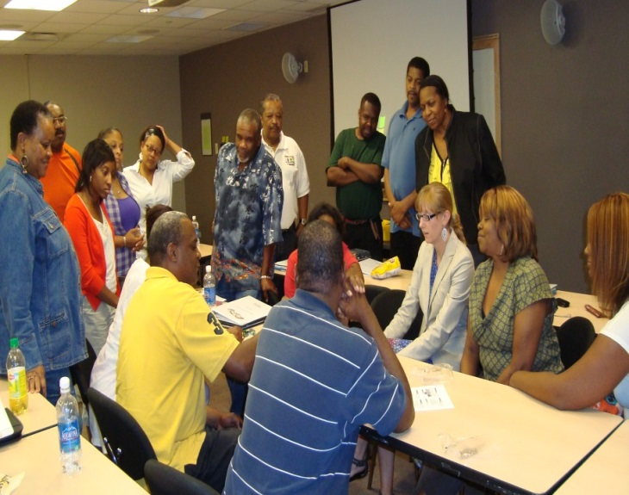
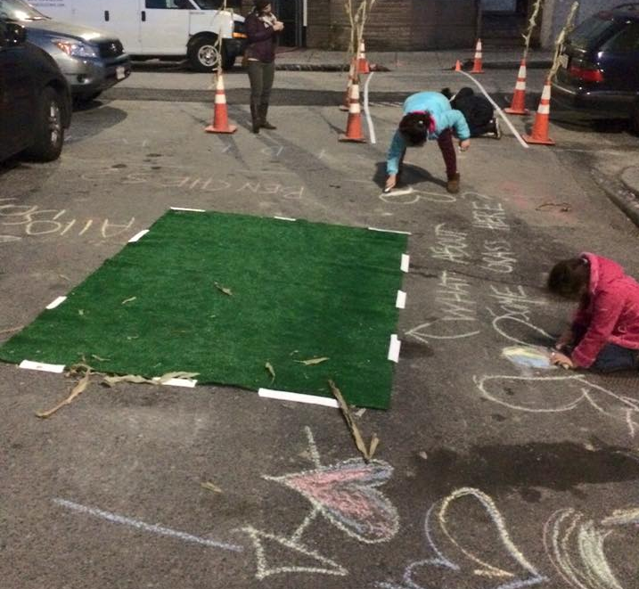
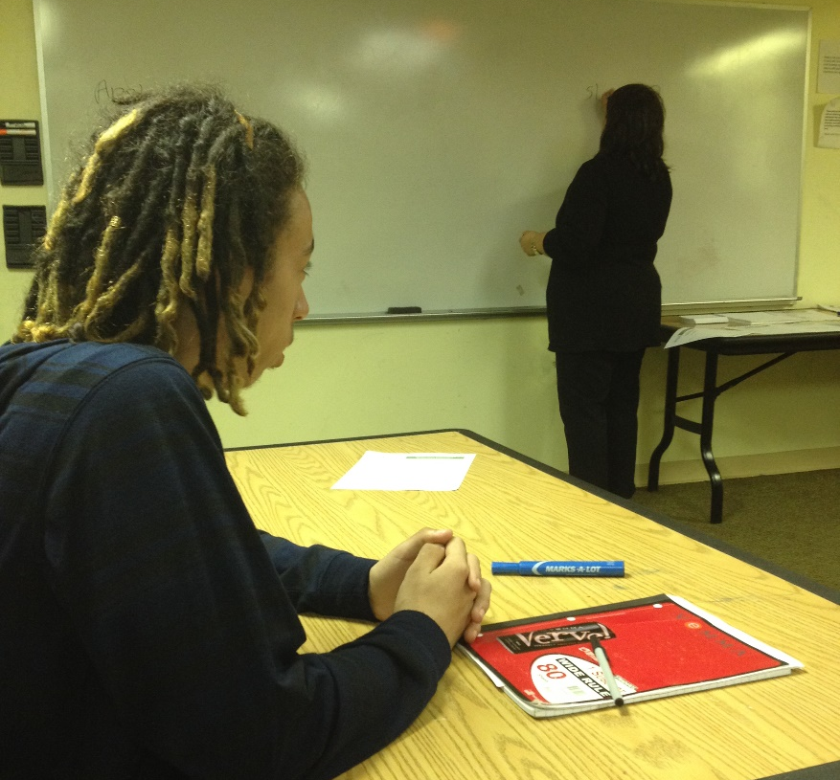
CCHERS CRITICAL MASS TOOLKIT TRAININGS
TRANSIT EQUITY & HEALTH
11
Codman Square
East Boston
Jamaica Plain
North Dorchester
Roxbury
South Boston
COMMUNITY
HEALTH CENTERS
27
YOUTH PARTICPANTS
OVER
SURVEYS IN ENGLISH AND SPANISH
MINI-GRANTS TO COALITIONS TO SUPPORT STRATEGIC ISSUES
900
3
CDC PARTNERS: NUESTRA COMUNIDAD
MADISON PARK
URBAN EDGE
OBSERVED OPEN SPACE DEMONSTRATION
NOAH & MAPC
PLACEMAKING
YouthHUB
3
COHORTS,
23 OVERALL
COMMUNITY INVESTMENT
4 COMMUNITY GRANTS TO SUPPORT CITYWIDE INITIATIVES
50
PEDESTRIANS SURVEYED
100%
COMPLTED 75% OF GOALS
EAGLE HILL PARTICAPNTS 10 BI-LINGUAL
32
100%
OBTAINED JOBS
Notes:
PHILLIP All of the grants that BACH is able to make are funded from Community Health Initiatives from hospital determination of need processes. This past year we were able to make a total of nearly $200,000 which accounts for half our annual budget. At last year’s annual meeting, we announced the four organizations to which the Community Investment Committee awarded grants to work on some of the strategic issues identified in the MAPP report…and a year later we can report on the excellent work they did
Youth Hub
Using a participatory action research model, YouthHUB focused on youth employment opportunities in Dorchester through a series of Youth Cohorts, workshops, coaching, peer leadership and employer and community support activities. This resulted in 100% of participants obtaining a job. They are now talking with Mattapan United about replicating this approach in that neighborhood.
JP Tree of Life/Arbol de Vida
Focusing on bus transit equity and its connection to community health, this coalition with its partners, JP Racial Justice and Equity Collaborative, Southern Jamaica Plain Health Center, Codman Square Health Center, CCHERS, Alternatives for Community Environment (ACE) and On The Move Boston worked to engage community health center leadership in understanding that poor transportation impacts health by limiting access to food, work, worship, school, community, beyond limiting access to healthcare appointments. Eleven health centers participated in surveying 928 respondents gathered very useful information including the need for more frequent and on-time buses.
CCHERS
The Center for Community Health, Education, Research, and Services, provided three training intensives on health equity, social determinants of health, and advocacy skills…one for teens, one for staff and board of community development corporations and one for coalition and other community-based organizations.
NOAH
Neighborhood of Affordable Housing in East Boston, partnered with the Metropolitan Area Planning Council on a place-making project which was a year-long process of public visioning to improve the health and walkability in highly traffic impacted communities of color. Through a photo-voice project in the Eagle Hill neighborhood of East Boston, and a survey of 400 residents conducted by NOAH’s Youth Research Organizers, they developed a plan for the redesign of the Clark Square intersection culminating in a demonstration of traffic calming and open space reclamation and a Dia del Maiz (Day of Corn) harvest festival in this heavily Central American neighborhood.
In addition, BACH provided some small grants to neighborhood coalitions to address one or more of these strategic issues at the neighborhood level. Five that we are highlighting are:
South Boston Collaborative Advisory Committee who continues its leadership in addressing trauma and resilience. They convened an intensive training on Psychological First Aid which attracted over 140 participants. They are active members of the All Hazards Psychological Trauma Network developed by our speaker, Atyia Martin, when she was at the Boston Public Health Commission. And they continue to valiantly address the opioid epidemic and its resultant overdoses and suicides in the neighborhood
Jamaica Plain Tree of Life/Arbol de Vida who completed an assessment of youth employment programs in Boston, and specifically in JP. They used a “designing from the margins” framework picture and identified that there were no programs who target undocumented or illiterate youth; most programs do not have a mental health component or home visits and are almost all focused on summer employment and for those who speak English.
Roxbury Community Alliance for Health/Whittier Street Health Center Our coalition provided 14 youths from the community with employment to participate in our trauma project. Our achievements were measured by the involvement of youth in a project that allowed them to become knowledgeable on the long-term negative effects of trauma, provide psycho-education on trauma to the individuals in their communities they interviewed as well as be active members of a Youth Advisory Board geared at helping them bring their voices and ideas to current issues facing the community. The project also helped them to develop their skills in leadership, advocacy, and community activism. Youth participants were trained on trauma by our community clinician and then were sent out in the community to conduct individual interviews with community members focused on trauma awareness.
Codman Square Neighborhood Association accomplished many things including youth distributing 6500 brochures promoting the Fairmont Line and the Talbot Ave. T stop; continued focus on healthy food and beverages including running the Codman Square Farmers Market and getting 2 neighborhood stores to promote healthy beverages); successfully getting 6 stores fined for selling tobacco to minors; and helping install wayfinding signs to increase walking and biking in the neighborhood. And the leadership development work of CSNC continues with BOLD Teens alumnae Shayna Holloway now the adult leader of BOLD Teens and Nebby Stephens, Codman Square Health Center’s first pediatric patient and community resident hired as a nurse practitioner at the health center.
North Dorchester Coalition: Piloted an anti-violence initiative called PeaceKeepers, which trained 24 youth between the ages of 13-20 over the summer from two sites, Girlz Radio and Project RIGHT. The curriculum developed, used conflict resolution, de-escalation and mediation skills as tools to give young people the power to affect change in their community with adult support. Youth participants were able to use these skills during summer programming and in daily life, when higher instances of violence tend to happen amongst youth in Boston.
And now, I would like to introduce Jessica Del Rosario who is BACH’s lead facilitator of a pilot program called AHEAD…

Slide 10
ADVOCATE FOR CHANGE AT THE STATE AND CITY LEVEL
SUPPORT MPHA’s Act FRESH CAMPAIGN
Food access, zoning, and physical activity
DETERMINATION OF NEEDS:
Work with MDPH and hospitals for equitable allocation of funds
SHARED DATA PLATFORM:
Advocate with COBTH for collaborative approach to community health needs assessments
COMMUNITY HEALTH WORKERS:
CHW Certification and long-term financing through MCO’s and ACO’s
COMMUNITY HEALTH NETWORK AREAS:
Strengthening partnerships with hospitals and MDPH
SUPPORT POLICY CHANGE WITHIN COMUNITIES TO IMPROVE COORDINATION OF SERVICS
POLICY & ADVOCACY
Notes:
David A We are also focused on some specific policy and planning issues that will move the strategic goals forward. Some of our activities include:
Active support for the MA Public Health Association’s act FRESH initiatives around food access, zoning, and physical activity.
Working to educate decision makers about the value of Community Health Workers with the goals of implementing CHW certification (which is ready to go but is caught up in the “no new regulations” gubernatorial order and seeing that MassHealth require the use and financing of CHWs in their new contracts with Managed Care and Accountable Care organizations so that CHWs are not only financed through short-term grants.
Active partnering in the planning processes for Determination of Need Community Health Initiatives with the Department of Public Health and (this year) with Steward Health Care, Boston City Hospital, Brigham and Women’s Hospital and, in the coming year, Mass General Hospital and Children’s Hospital.
Organizing other Community Health Network Areas (BACH’s equivalents around the state) to advocate for continued meaningful engagement in health planning process with hospitals and the Department of Public Health.
Advocating with Conference of Boston teaching Hospitals and others to work towards developing a shared data platform across all sectors and a more collaborative approach to community health needs assessments.

Slide 11
BACH INITIATIVES: AHEAD & LET’S GET HEALTHY, BOSTON!
Notes:
DAVID A And now, I would like to introduce Jessica Del Rosario who is BACH’s lead facilitator of a pilot program called AHEAD…

Slide 12
AHEAD:
Aligning Health Equity and Development
PARTNERS:
BACH
Brigham & Women’s Hospital
Boston Department of Neighborhood Development
Boston Medical Center
Boston Public Health Commission
Carney Hospital
Codman Square NDC
Codman Square Neighborhood Council
Kit Clark Senior Center
HRiA
Public Health Institute
GOAL:
Bring together many of the health, social service, business and community development organizations and residents to identify opportunities for addressing one or more health inequity and develop metrics to track progress.
FOCUS:
Improving food systems in the neighborhood and its connection to health in housing
TARGET NEIGHBORHOOD:
Codman Square
Notes:
Jessica Del Rosario Last winter, BACH was chosen to be the Boston participant in a national pilot program AHEAD (Aligning Health Equity and Development. AHEAD’s goal is to bring together many of the health, social service, business and community development organizations and residents in a distinct neighborhood to, through a relatively short community process, identify where there are opportunities for addressing one or more health inequity that a collective effort and investment of time, human and other resources of all these players can agree to address, along with agreed upon metrics to track progress. After an RFP process, along with the national consultants from the Public Health Institute in Oakland, CA we selected the Codman Square neighborhood. The Convergence working Group we have formed has narrowed down the possible initiatives to focus on improving the food system in the neighborhood and its connection to health in housing.
Now I would like to introduce Tamika Francis, BACH’s Community Engagement Manager of the Let’s Get Healthy Boston! initiative.

Slide 13
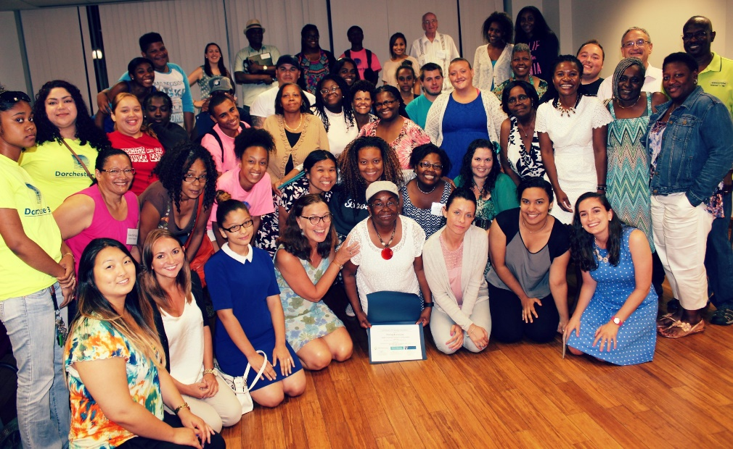
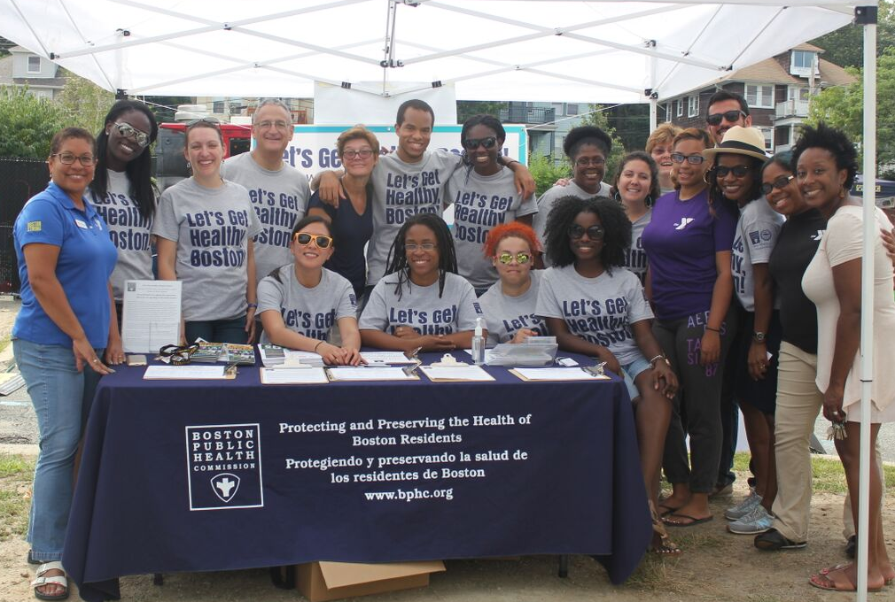
LET’S GET HEALTHY, BOSTON!
10
NEIGHBORHOODS
GOAL:
In partnership with BPHC, our in aim is to reduce the burden of chronic disease by addressing the health behavior risks of tobacco exposure, poor nutrition and lack of physical activity through increased access to smoke free housing, healthy food and beverage, and active transit.
HEALTHY COMMUNITY CHAMPIONS (HCC) TRAINING
OVER 35
CITYWIDE
PARTNERS
75
HEALTHY COMMUNITY CHAMPIONS
LGHB!
KICKOFF EVENT
Notes:
TAMIKA At last year’s annual meeting (which I attended before starting on my work with BACH) we announced that Boston Public Health Commission had been awarded a three year Partnerships Improving Community Health (PICH) grant. BACH is the lead community partner. In turn we and BPHC are partnering with 10 community based organizations and have built the Healthy Community Champions (HCC) program which I have been leading since I joined the BACH staff in January. These ten organizations have recruited a diverse multi-racial, multi-language, group of men and women from age 14 to 72 from neighborhoods all across the city.
Along with Health Resources in Action, we designed and delivered an 8 week training course that introduced HCCs to some of the language of public health (health equity, social determinants of health), some of the “how to’s” of advocacy and leadership, and overviews of the public health issues the grant is focusing on: tobacco use, healthy food and beverages, and increased walking and biking.
On September 19, we held a public launch event at the Roxbury YMCA , attended by over 300 people, including Congressman Michael Capuano, Boston’s Chief of Health and Human Services, Felix Arroyo, City Councilor Tito Jackson, and acting Executive Director of the BPHC Huy Nguyen revealing the new name of this work: Let’s Get Healthy Boston!
These champions are working to help us implement voluntary policy, systems, and environment changes that will make the healthy choice the easy choice for some of the leading contributors to chronic disease.
Increasing the number of Smoke free housing units in multi-family buildings
Improving access to Healthy food and beverages through promotions of Farmer’s markets, Boston Bounty Bucks that double the buying power for SNAP (Food Stamps) recipients, a digital tracking system and renewed support from Boston’s teaching hospitals and working with the CVS and Walgreen’s Pharmacy chains on the promotion of healthy beverages and the Boston Public Health Commission’s Rethink your Drink campaign that Stop and Shop adopted this year
Increasing access to active transit including HubWay bike share utilization and subsidized memberships and the implementation of a Safe Routes to School with 26 Boston Public Schools’ elementary and middle schools and some charter schools
Due to the recent budget negotiations between the Obama administration and the Congress, the third year of funding for PICH projects such as ours, has been under threat and, as of now is not included in the federal budget for 2017 (starting next fall). During the summer and this fall, we have been actively advocating for the continuation of PICH and Boston got a shout out from the national advocacy coordinators for having the greatest volume of emails and tweets to Congress regarding this issue.
And finally I’d like to ask all the Healthy Community Champions who are here tonight to stand and be recognized. (applause)

Slide 14
“
Making change does not happen on its own. It requires people to come forward to tell their story and speak the truth; to organize and inspire others to work together and to take action. Boston is a different place than it was 20 years ago and these awardees are a few of the people who are leading us into the future.
HEALTHY COMMUNITY LEADERSHIP AWARDS
”
-DAVID ARONSTEIN,
BACH DIRECTOR
Notes:
And finally, we decided to initiate a Healthy Community Leadership award program. For this portion of the program, I would like to introduce Vivien Morris, Director of Health Planning and Racial Equity at the Boston Public Health Commission and the Chair of BACH’s Health Planning and Improvement Committee.
Vivien The Steering Committee decided to start the Healthy Community Leadership Award as one small way we could lift up leadership from communities of color, immigrants, and underrepresented groups who have been active leaders in community health and shown leadership qualities such as
high integrity;
excellent listening skills;
ability to collaborate and work well with others;
ability to facilitate the development of others’ leadership skills;
ability to inspire others and convey their vision;
earned respect from those with whom they work.
And now to the Awards:

Slide 15
“
I think it just happens. When I have the opportunity to do more, I decided that I want to and the people around me really support me, which is nice.
HEALTHY COMMUNITY LEADERSHIP
AWARDEE
”
AMAL ANWAR
Notes:
Amal has been an advocate for tobacco/substance abuse prevention, racial justice, as well as many more issues facing her community. She has coordinated and participated many projects to address these issues. For the past three years, she has also been an active member of the Statewide Leadership Team of the 84 Movement, a statewide movement of youth fighting tobacco in Massachusetts. The 84 represents the 84% of Massachusetts youth who did NOT smoke when the movement began. Now, 89% of youth do NOT smoke. She has presented and co-facilitated workshops and trainings to peers, educators, stakeholders, legislators and other community leaders. As a young woman of color, she has motivated and empowered her peers to get involved with The 84 Movement and take action to fight big tobacco. In addition to being a part of the Statewide Leadership Team and the YWCA Task Force, she is also the president of two clubs at her school: Interact Club and Leadership and Mentoring Club (LMC). Interact club organizes students to go participate in volunteer opportunities and with LMC she provides mentoring to middle school students.
Amal he has a strong grasp on what is effecting her community regarding tobacco-related issues and health implications. When she has been asked to take on a task or take a leadership role on something, she always raises to the occasion, no matter what is asked of her. She puts an incredible amount of effort to be as prepared as possible for any occasion where she is presenting information. As someone who is more reserved, she is a strong critical thinker and takes the time to observe and formulate her ideas and opinions. When she began with the Statewide Leadership Team, she was enthusiastic and engaged, but over the last three years she has really pushed and empowered herself to take action and be a vocal leader.

Slide 16
“
I’m motivated every day, just from coming in and seeing a new face or seeing that Mom that thinks she can’t, but CAN.
HEALTHY COMMUNITY LEADERSHIP AWARDEE
”
CAROL MIRANDA
Notes:
Carol works with Smart from the Start, a family support, community engagement and school readiness organization that has as its mission to prevent the academic achievement gap among young children living in the lowest income families and communities. Smart empowers parents and caregivers in under-served communities with the tools, resources and support they need to break cycles of chronic school underachievement and generational poverty.
Carol has worked successfully to:
reach out , through door-knocking and other creative outreach strategies, to those very low income families in Jamaica Plain’s Bromley Health and South St. housing developments who are most isolated from their surrounding community and least connected to health and social services
capitalize on these parents’ desire to do what’s best for their children to engage them in everything from parenting workshops to GED courses to employment training
connect them and their children to health and social services that they would not otherwise have taken advantage of
Carol has succeeded in:
engaging numerous previously isolated families with young children in activities that have reduced their isolation, improved their self-image and sense of efficacy, and built a sense of community, including having several of them successfully run for seats on the tenant task force
engaging all of the child- and family-serving organizations in the Jamaica Plan neighborhood in an effort to better serve these families through improved coordination, including monthly meetings where participants report on efforts to coordinate and update one another on upcoming activities
organizing community-building events and activities that have broadened the circle of engaged families
Carol is well liked and respected by the residents and community organizations for her energy and focus on improving the lives of the children and families in our community. Just last month, Carol pulled together a spontaneous picnic for the seniors over at Bromley. This age group is not her area of focus, but because she discovered by talking with a few elderly residents that they felt left out and nothing was being offered for them, she asked all of the community partners to chip in and make a picnic for the seniors. Everyone responded and Carol hosted a wonderful event! The seniors were thankful and appreciated the effort. Carol is a true community worker whose passion, commitment and energy is recognized by all who know her!

Slide 17
“
I’ve lived in Mattapan all my life. But everywhere I go and everywhere I work, I always make my own little family. They keep me motivated and connected to everything I’m doing.
HEALTHY COMMUNITY LEADERSHIP AWARDEE
”
SHAVEL’LE OLIVIER
Notes:
Shavel’le is a leader in the Mattapan community. She has a passion for the health of Boston and for Mattapan in particular. She joined Mattapan Food and Fitness Coalition at age 15, and was a leader from the beginning. She participated in an evaluation of access to healthy foods and opportunities for active living in Mattapan as a young teen and became passionate about making improvements in our community. She co-led the youth wing of MFFC, the MFFC Vigorous Youth. She has now co-led 5 very successful Mattapan on Wheels biking events. A center piece of the event is developing biking routes that celebrate what’s good about Mattapan – our existing parks and green spaces and neighborhoods – and also highlighting what is needed – the completion of the Mattapan section of the Neponset River Greenway and the Fairmount Greenway. Additionally, she has served for many years as the assistant manager for the Mattapan Square Farmers Market.
An example of her leadership qualities is her willingness to take the initiative to bring resources to MFFC that will help the youth of Mattapan. This year, she and another youth leader took the initiative to respond to a request for proposals from the Attorney General’s office to stipend youth jobs. She and another youth successfully wrote the grant, received the funding, hired 15 youth, and oversaw their work in Mattapan, helping with the farm stand, farmers market, playway, and other positive Mattapan activities. Finally, an example of Shavel’le’s leadership and the respect she receives from others is that she now coordinates the MFFC leadership team. She recognized that our organization needed to focus on a number of infrastructure enhancements in order to meet our expanded role in the community. As a result of her strong voluntary leadership, the group elected her to the new position of Co-Chair of MFFC.

Slide 18
“
Seeing myself as an effective leader can be difficult at a young age, because I’m very close in age to the students I help serve. But just being in these spaces and being present is sometimes a great start and sometimes it’s enough. But I always strive to do more and it’s really empowering.
HEALTHY COMMUNITY LEADERSHIP AWARDEE
”
REGINAULD WILLIAMS
Notes:
Reggie began his community engagement work through media at the age of 15 when he began working as a Media Literacy Educator as part of the original Media Leadership Team at Press Pass TV and is now the Community Relations Manager. Press Pass TV is organization that uses the power of media arts to provide meaningful employment and education for youth living in low-income neighborhoods. We offer creative outlets for self-affirmation, teach life sustaining skills and empower communities with the resilience to thrive. As a spoken word artist, he annually teaches a workshop around restorative justice, healing and our shared role in the media.
He has worked with the Boston Public Health Commission as a part of the REACH (Racial and Ethnic Approaches to Community Health) grant program to combat hypertension and obesity in communities of color. While contributing to the communications and outreach plan for the grant partners to utilize in their efforts, Reggie and his team shared their best practices and challenges with health as a model of leadership for their students.
While working at Blue Cross Blue Shield of Massachusetts (BCBSMA), Reggie served as a project coordinator with the Corporate Communications team on the 2014 National Influenza Vaccination Week, a program promoting flu awareness and vaccinations presented by BCBSMA, Walgreens and the BPHC. He is on the New England Leadership Council of the United Negro College Fund (UNCF) and the Leadership Council of MassCreative, a statewide arts advocacy organization that works with creative leaders, working artists, arts educators and arts and cultural supporters to empower creative organizations and the public with a powerful voice to advocate for the resources and attention necessary to build vibrant, connected, and creative communities.
After ten years of work in the media and nonprofit community in the Greater Boston area, Reggie still strived to promote access to physical, mental and spiritual health to his students. Reggie can often be found on a run, or in the gym where he is able to continuing mentoring the youth of his program while working to set an example for overall health and wellness.

Slide 19
“
I am always inspired and impressed by my clients- who I work with, who will come in and say, ‘I lost my job, I don’t have a place to stay, I think I may be HIV positive, but yet I have a smile on my face and doing all these awesome things in my life.’
HEALTHY COMMUNITY LEADERSHIP AWARDEE
”
COREY YARBROUGH
Notes:
Corey is the founder of the Hispanic Black Gay Coalition in Boston. HBGC brings together LGBTQ people of color for a range of advocacy, support, and leadership development opportunities. In addition, they convene “identity groups” such as lesbian Latinas of color
Corey has taken this organization from nothing to an influential organization within and outside of the LGBTQ community. They have developed a leadership training program for youth and young adults and recently held its fifth annual Youth Empowerment Conference, New England’s largest gathering of LGBTQ youth of color and their allies. They have also sponsored and supported Straight/Gay Alliances in a number of high schools in Boston whose students are mostly people of color. They have also supported increased HIV testing for people of color.
Corey is a soft-spoken and eloquent advocate for social justice and equity. He understands the connections between racism, homophobia, social determinants of health and health outcomes and articulates the ways in which LGBTQ people of color are receiving inequitable care and services and poorer health outcomes and works to overcome these inequities.

Slide 20
“
My job is to help make connections between the racism, and busing, and desegregation and our history to this world of resilience and to how we can reduce traumatic outcomes after disasters.
KEY NOTE:
DR. ATIYA MARTIN
Q&A
”
-DR. ATIYA MARTIN,
CITY OF BOSTON
CHIEF RESILIENCE OFFICER

Slide 21
COMMUNITY COALITIONS
Arnesse Brown
South End Healthy Boston Coalition
Sara Coughlin
Charlestown Substance Abuse Coalition
Valerie Frias, Chair
Allston Brighton Health Collaborative
Daryl Goldstone
Codman Square Neighborhood Council
Chien-Chi Huang
Healthy Chinatown Alliance
Cynthia Lewis
Mattapan United
Jamiese Martin
Franklin Field/Franklin Hill Dorchester Healthy Boston Coalition
Matt Parker
North Dorchester Coalition
John Riordan
Jamaica Plain Tree of Life/Arbol de Vida
Kay Walsh
South Boston CAN
HOSPITALS &
HEALTH CENTERS
Magnolia Contreras
Dana Farber Cancer Institute
Denise de las Nueces
Boston Health Care for the Homeless
John Erwin, Treasurer
Conference of Boston Teaching Hospitals
Ryan Ribeiro
Harbor Health Services
COMMUNITY-BASED ORGANIZATIONS
Juan-Carlos Ferrufino
Office of New Bostonians
Philip Gonzalez
Community Catalyst
Lilly Marcelin
Resilient Sisterhood Project David Price
Nuestra Comunidad Development Corporation
Charlotte Spinkston, Clerk
Urban Pride
Vacant Seat
CITY & STATE HEALTH DEPARTMENTS
Damon Chaplin
MA Department of Public Health
Vivien Morris
Boston Public Health Commission
Re-Election and New Members
STEERING COMMITTEE ELECTIONS

